Slide 1
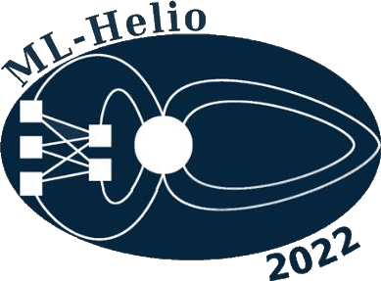
ML-Helio 21-25 March 2022
Electron Radiation Belt model incorporating
the semiannual variation and interplanetary solar drivers
(SENTINEL)
S. Aminalragia-Giamini^{(1,2)}, Ch. Katsavrias ⁽¹⁾, C. Papadimitriou^{(1,2)}, I. A. Daglis^{(1,3)}, I. Sandberg⁽²⁾, P. Jiggens⁽⁴⁾
Department of Physics, National and Kapodistrian University of Athens, Greece.
Space Applications and Research Consultancy (SPARC), Athens, Greece
Hellenic Space Center, Athens, Greece.
ESA/ESTEC, Netherlands.

Slide 2
Outline
Introduction - motivation
Electron flux data
Solar drivers and semi-annual variation - Russell-McPherron effect angle
Methodology
Results Van Allen Probes GOES
Conclusions and discussion

Slide 3
Introduction - motivation
Outer Radiation Belt contains electron populations in a large energy range source (10-100 keV) / seed (100-300 keV) / relativistic (≥ 0.5 MeV)
These populations can cause surface charging, data errors, instrument errors, internal charging and satellite loss at extreme cases
RB dynamics are driven from solar activity
Can we use solely solar wind/activity parameters to predict conditions in the Outer Belt?
In what time-scale, energy range, and L range?

Slide 4
Electron flux data
Training/Testing
Van Allen Probes/MagEIS (A+B) spin-averaged omnidirectional differential daily electron fluxes
Sep 2013 – July 2019 (~2100 days)
L = [2.6 – 5.8], 17 bins (dL=0.2)
Energy: 0.033 MeV – 4.062 MeV, 18 bins
L
Testing/Validation
E
GOES-15/EPEAD electron integral fluxes
2012–2018
GEO orbit
Energy: ≥ 0.8 MeV
Time

Slide 5
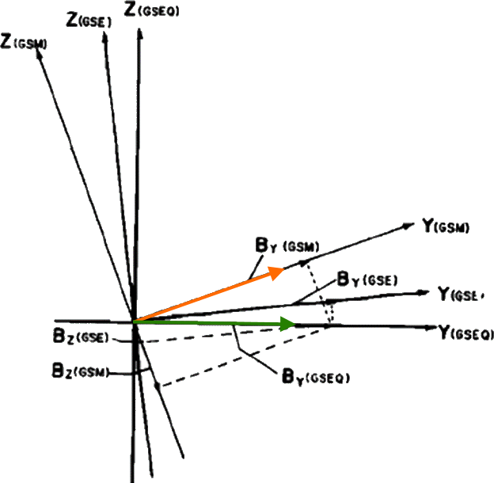
Input data
Solar drivers - OMNIWeb
Solar wind speed – Vsw
Solar wind pressure – Psw
Solar flux at 10.7 cm – F10.7
Angle of Russell-McPherron effect – tilt of the Earth’s dipole axis with respect to the heliographic equatorial plane (IRBEM)
adapted from Russell & McPherron, 1973

Slide 6
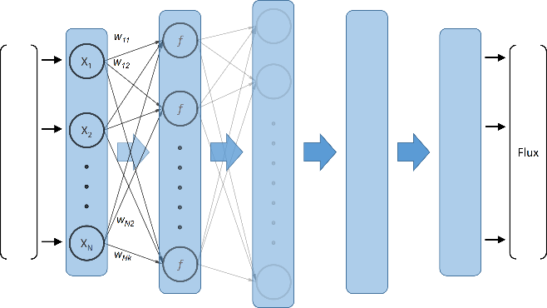
Methodology
Apply 30-day moving window on average & q95 on daily values of drivers and fluxes
Time window 29-previous and current day
L is “degridified” - used as an input parameter
Use T-1_{day} solar driver values to predict T_{day} electron fluxes
Output is mean and q95 values at 18 energies for input L
V_{sw}
P_{sw}
F_{10.7}
X_{solar}
mean, q95
Expected
mean & q95
daily electron flux
[0.033- 4] MeV
.
.
.
$$\frac{1}{N}\sum{F_{i}}$$
sin(θ/2)
cos(θ/2)
X_{Θ}
X_{L}
L

Slide 7
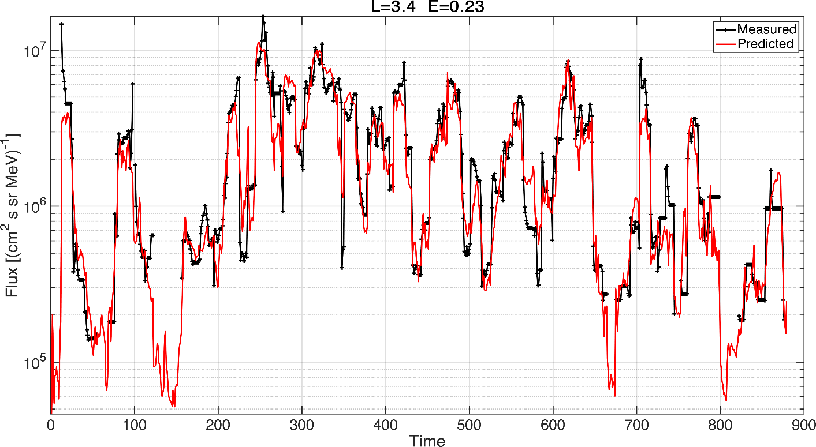
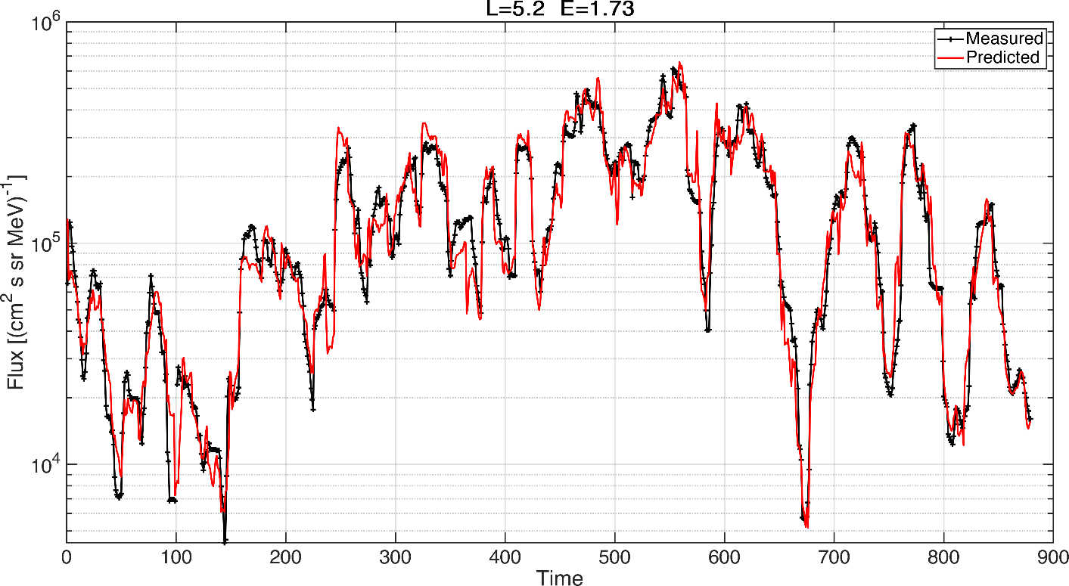
Results – Van Allen Probes
Random subdivision training testing 60-40 (train 1250 days – test 880 days) all L – all energies
Train: ~21000 samples Test: ~15000 samples (L degridification)

Slide 8
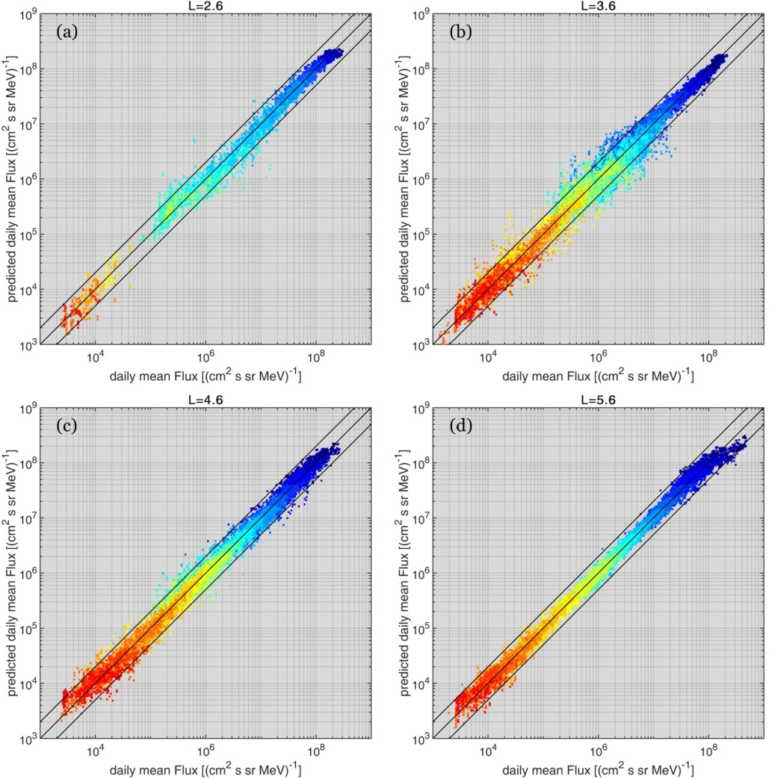
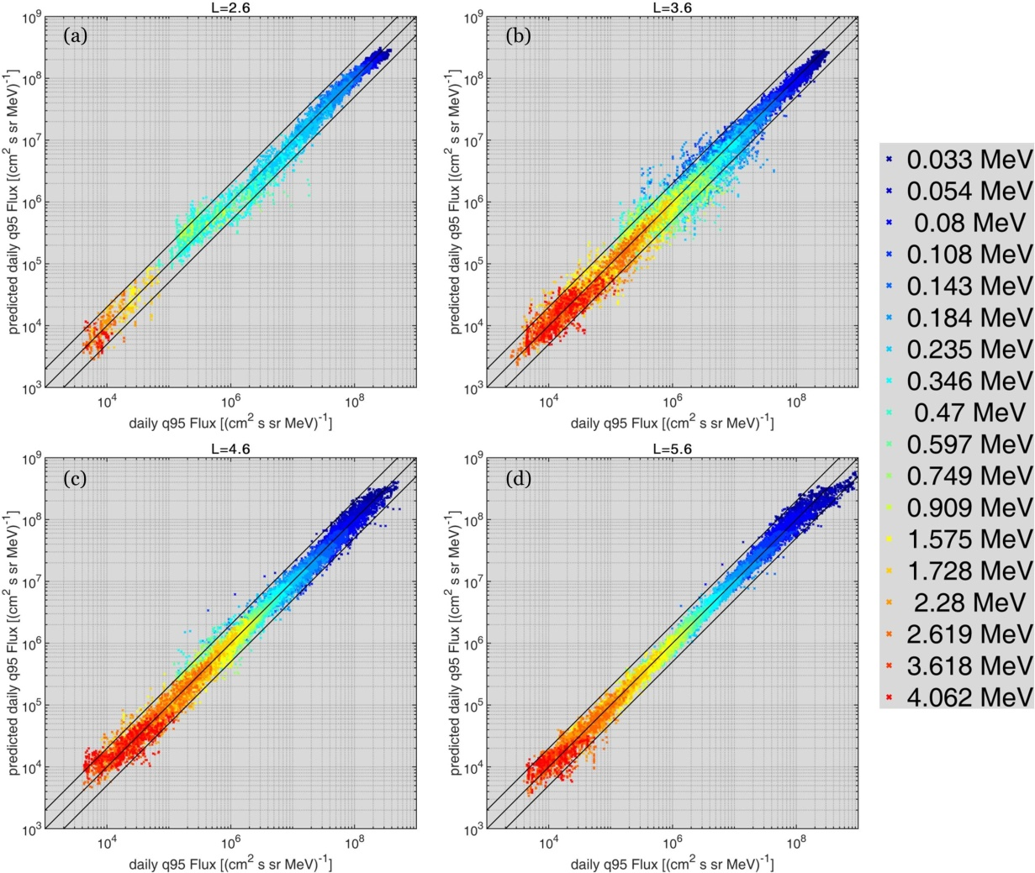
Results – Van Allen Probes
mean fluxes
q95 fluxes

Slide 9
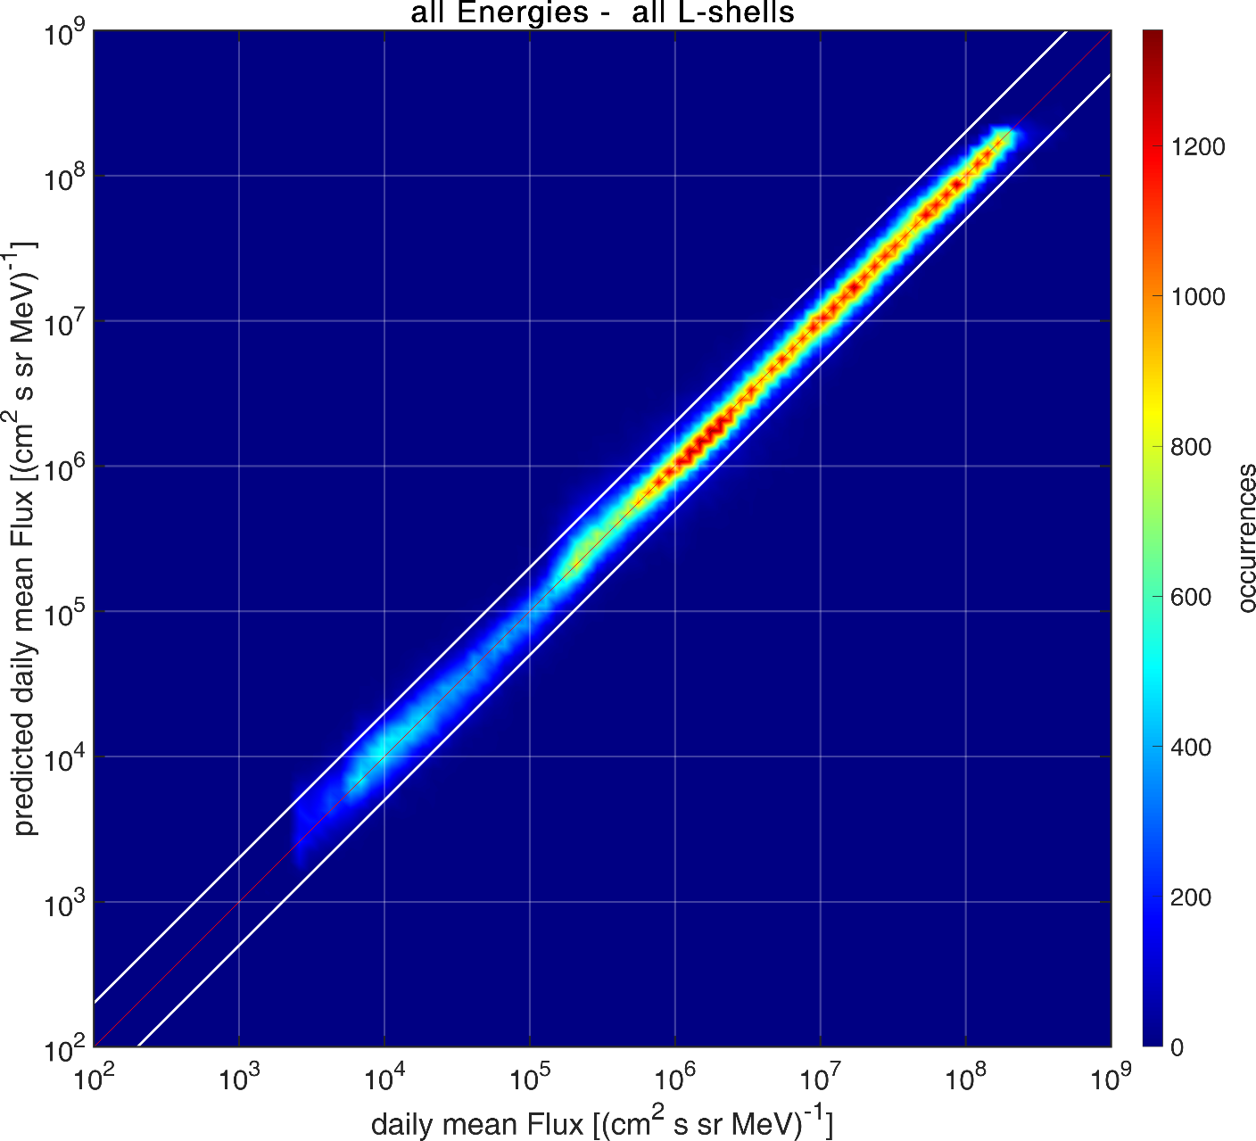
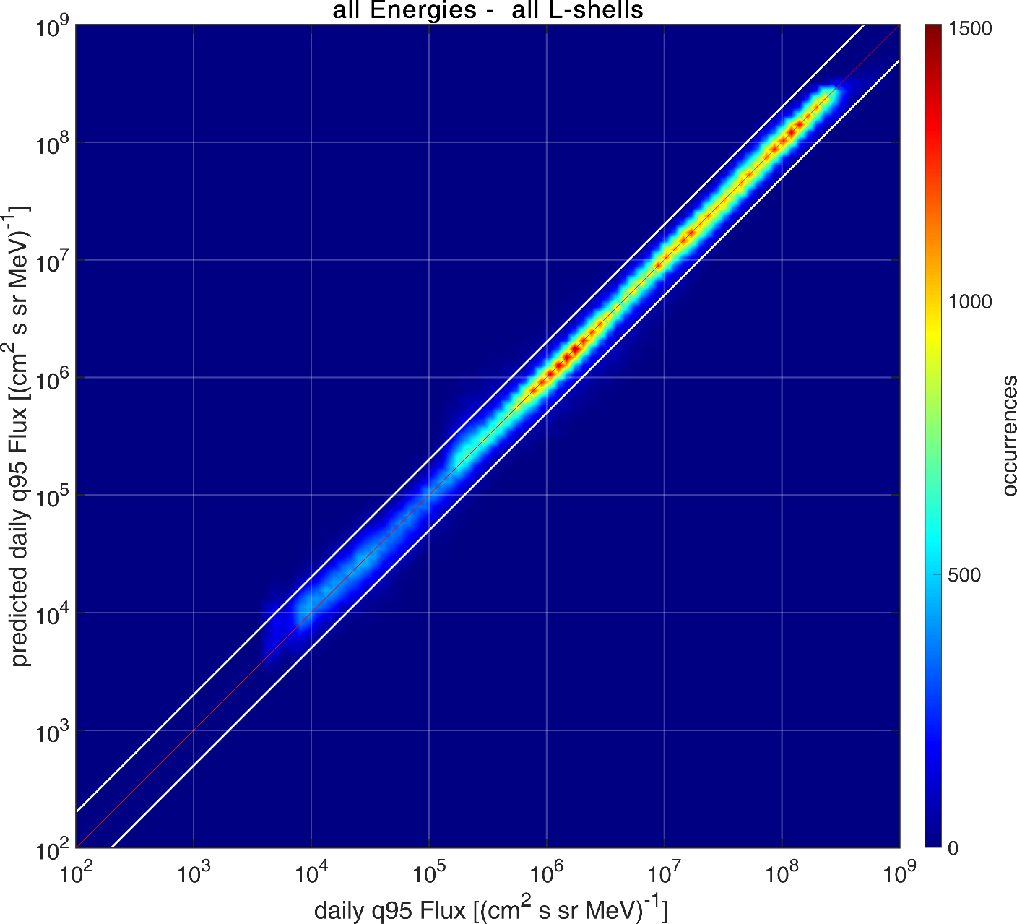
Results – Van Allen Probes

Slide 10
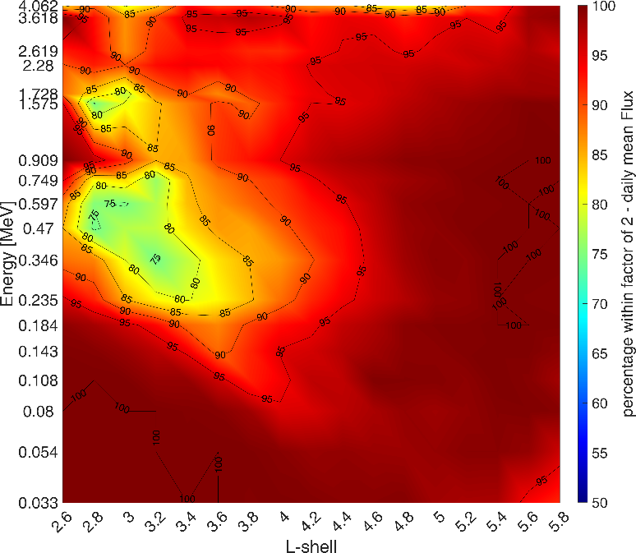
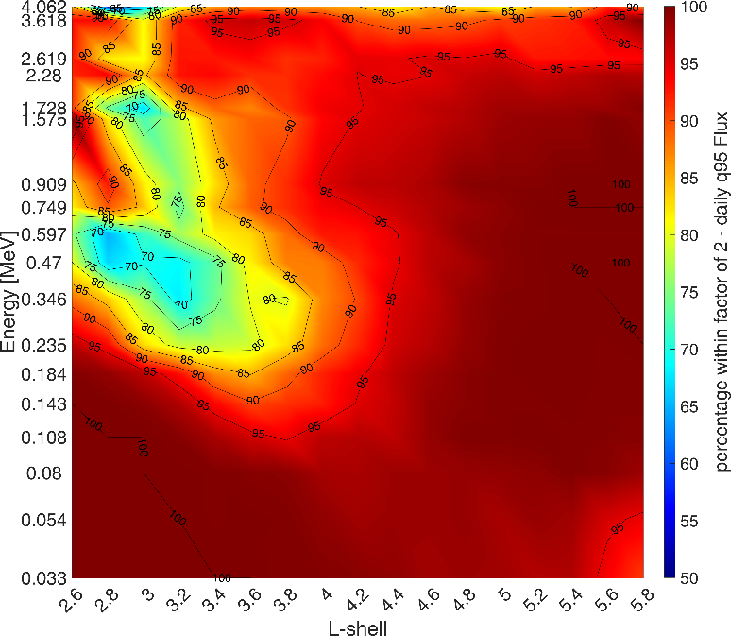
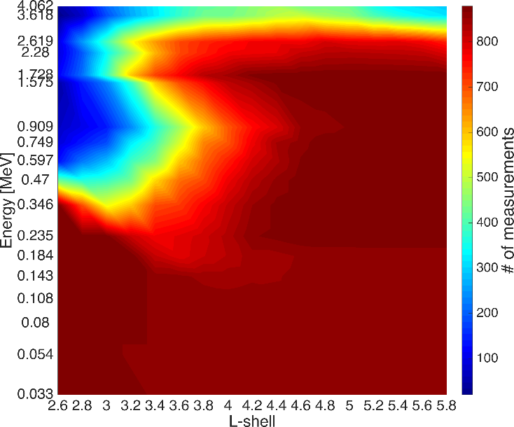
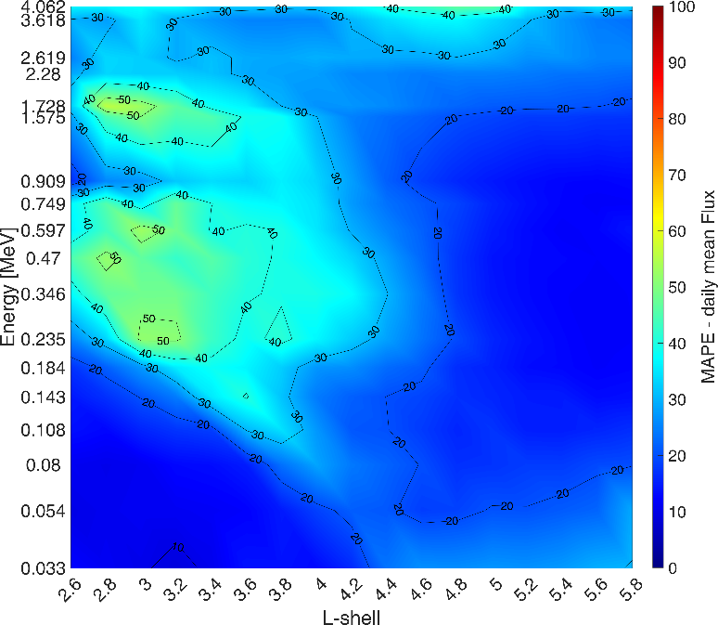
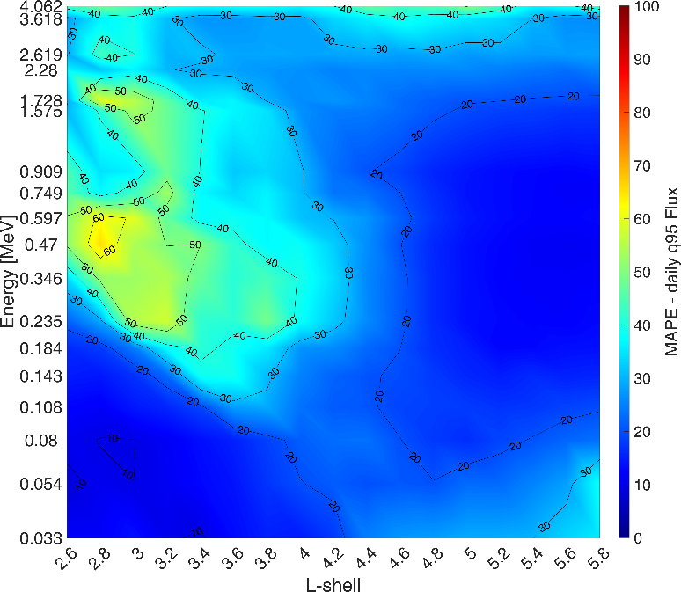
Results – Van Allen Probes
mean fluxes
q95 fluxes
Ratio within
a factor of 2
MAPE
$$\frac{100}{N}\sum_{i=1}^{N}{\left|\frac{M_{i}−P_{i}}{M_{i}}\right|}$$

Slide 11
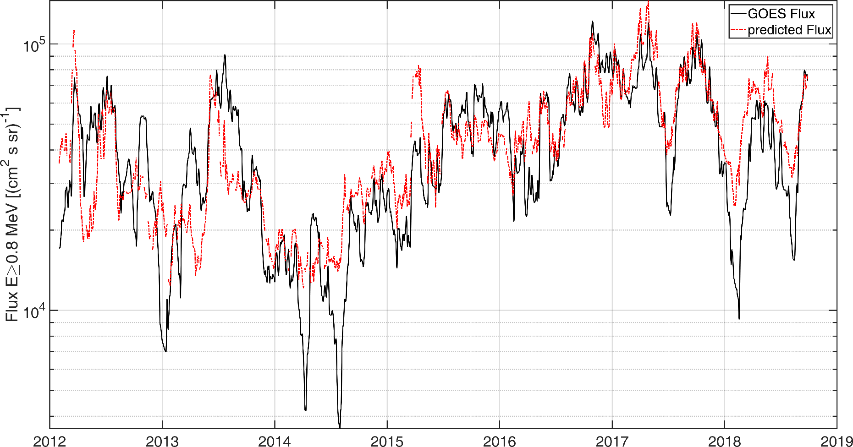
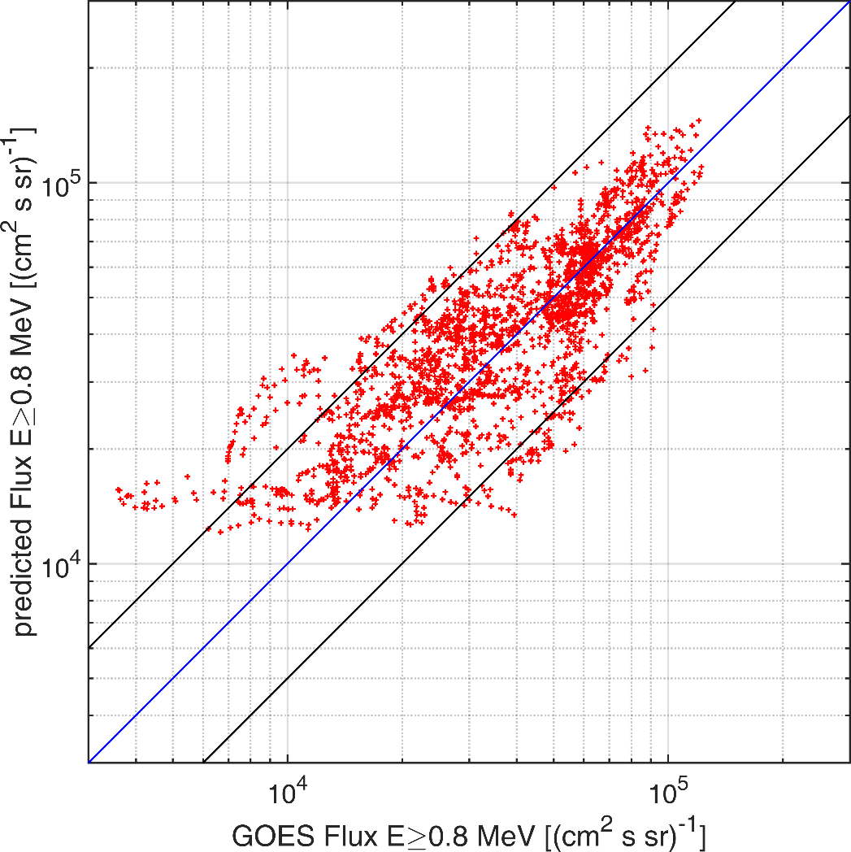
Results – GOES
Can the model generalize temporally and spatially?
Use L=6.65 ±0.05
Derive predictions for 2012-2019
Integrate predicted fluxes E≥0.8 MeV
Compare with respective measurements from GOES-15/EPEAD

Slide 12
Conclusions
Model developed on ~7 years (2013-2019) of VAP/MagEIS measurements for can successful prediction of next-day daily mean and Q95 values
Coverage from slot region to L≈6 and energy coverage from seed to relativistic (0.03-4 MeV) – spectrally coherent.
Prediction outside the training scheme - both temporally and spatially shown using GOES-15/EPEAD integral fluxes.
The use of solely exogenous variables enables a model not dependent on mission-specific data (previous fluxes)
Katsavrias et al. 2021, Radiation belt model including semi-annual variation and Solar driving (Sentinel), Space Weather, 19, e2021SW002936. https://doi.org/10.1029/2021SW002936

Slide 13
Discussion
Uses and applications for such a model?
Forecast electron fluxes – provide alerts for next days
Input for predicting surface and internal charging effects on spacecraft
Use in conjunction with other models/methodologies, which have a shorter forecasting horizon, in order to derive even more detailed predictions?
Serve as low-energy boundary conditions for studying electron acceleration to relativistic energies, e.g. ARASE/XEP E≥0.5 MeV ?
Use for calibration/comparisons of instruments with no suitable golden reference instrument ?
Fill mission datasets gaps? Background correction/smoothing?

Slide 14
Discussion

Slide 15
ML-Helio 21-25 March 2022
Thank you for your attention
sagiamini@sparc.gr
ckatsavrias@phys.uoa.gr

Slide 16
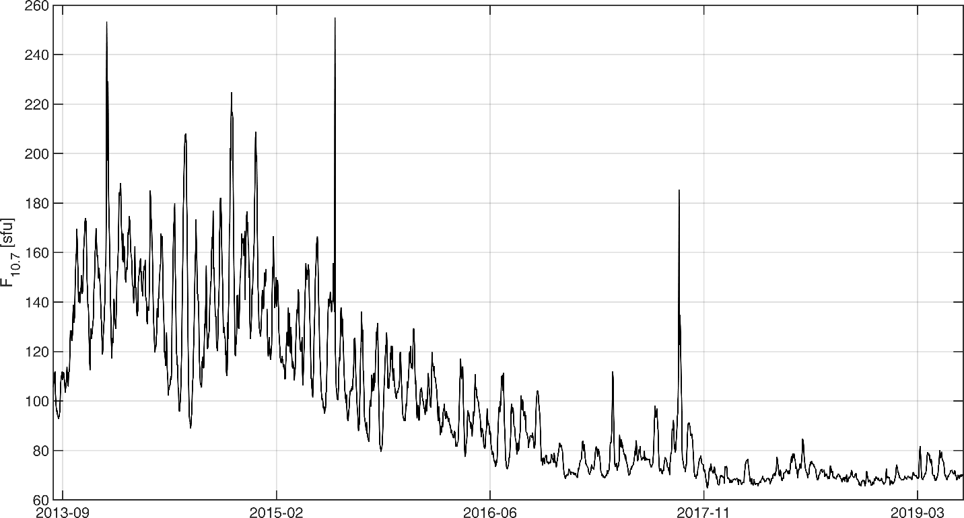
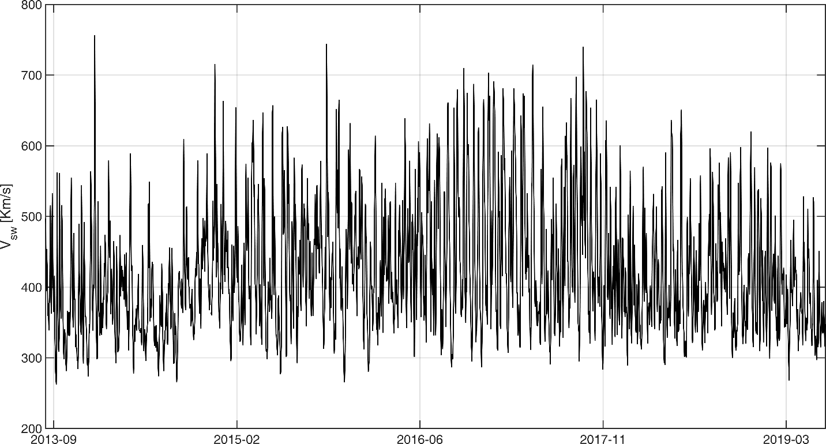
Backup slides
F10.7 is very inhomogeneous across the solar cycle

Slide 17
Backup slides

Slide 18
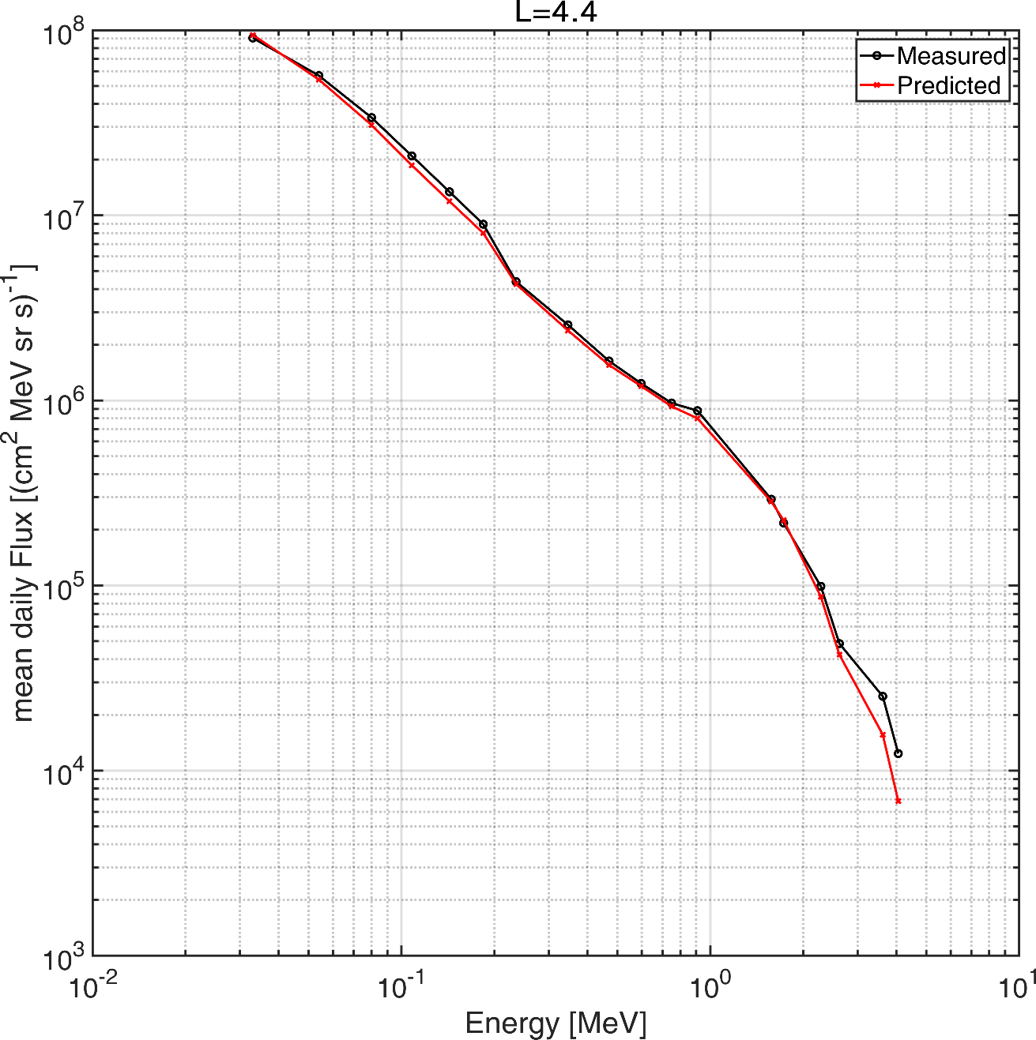
What about spectral coherency?

Slide 19
Backup slides
SAV paper
Katsavrias, C., Papadimitriou, C., Aminalragia-Giamini, S., Daglis, I. A., Sandberg, I., and Jiggens, P.: On the semi-annual variation of relativistic electrons in the outer radiation belt, Ann. Geophys., 39, 413–425, https://doi.org/10.5194/angeo-39-413-2021, 2021.

