Slide 1
ANN-based three-dimensional Ionospheric model: present state, challenges and future directions
V. Sai Gowtam^{1,2}, S. Tulasi Ram², Hyunju Connor¹ and Amy Keesee³
¹Geophysical Institute, University of Alaska Fairbanks, USA.
²Indian Institute of Geomagnetism (IIG), India.
³University of New Hampshire, USA.
Acknowledgements:
UCAR/CDAAC-Radio Occultation data
GIRO-Ground based Digisonde
Madrigal-Cornell University: ISR data
Omniweb: Kp-index and F10.7 flux
MAGICIAN team
Email: svalluri@alaska.edu
Email: svalluri@alaska.edu
ML-HELIO 2022, 21-25 March, 2022, Boulder, CO.

Slide 2
Outline
MAGICIAN
Motivation of the study
Database for ANNIM-3D
Results
Major Challenges
Future directions
ML-HELIO 2022, 21-25 March, 2022, Boulder, CO.

Slide 3
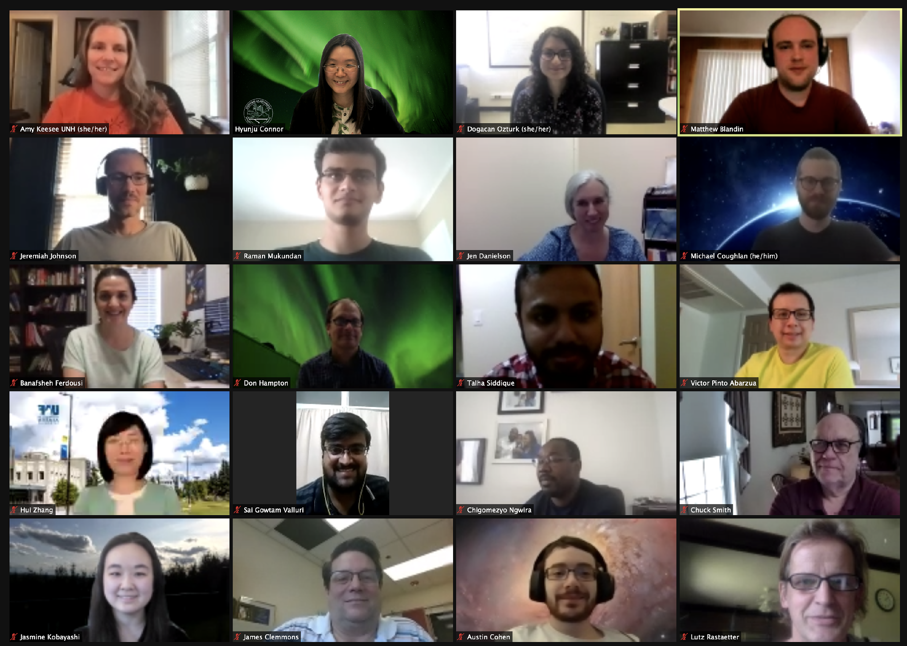
MAGICIAN Team
MAGICIAN is a joint UAF – UNH team funded by the 2018 NSF EPSCoR RII Track 2 Program that develops machine-learning (ML) algorithms for predicting hazardous Geomagnetically Induced Currents.
ML-HELIO 2022, 21-25 March, 2022, Boulder, CO.

Slide 4
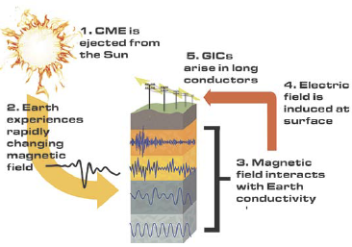
Geomagnetically Induced Currents (GICs)
MAGICIAN team addresses three key science questions using artificial intelligence with ever-growing space science dataset:
What transient solar wind features lead to large changes in the geomagnetic fields?
What magnetospheric and ionospheric (MI) parameters account for regional differences in geomagnetic field changes?
How can an array of simple, commercial magnetometers contribute to regional GIC Modeling?
Global & Local Geomagnetic Field Models
Ionospheric Plasma Convection Model
Aurora Image Classification Model
Electron density Model
Gannon [EEonline, 2016]
We focus on large geomagnetic field disturbances, a trigger of GICs.
SWUG: Building a cost-effective, research-capable magnetometer array for space weather research
ML-HELIO 2022, 21-25 March, 2022, Boulder, CO.

Slide 5
Motivation: Can we predict the ionosphere accurately with ANNs…?
Geomagnetic storms/
CIR
Diurnal (LT)
Latitude
Ionosphere
Longitude
Magnetic field
configurations
Neutral winds
Seasons
Forcing from Solar and neutral atmosphere
Solar activity
It is a complicated system…!!!
ML-HELIO 2022, 21-25 March, 2022, Boulder, CO.

Slide 6
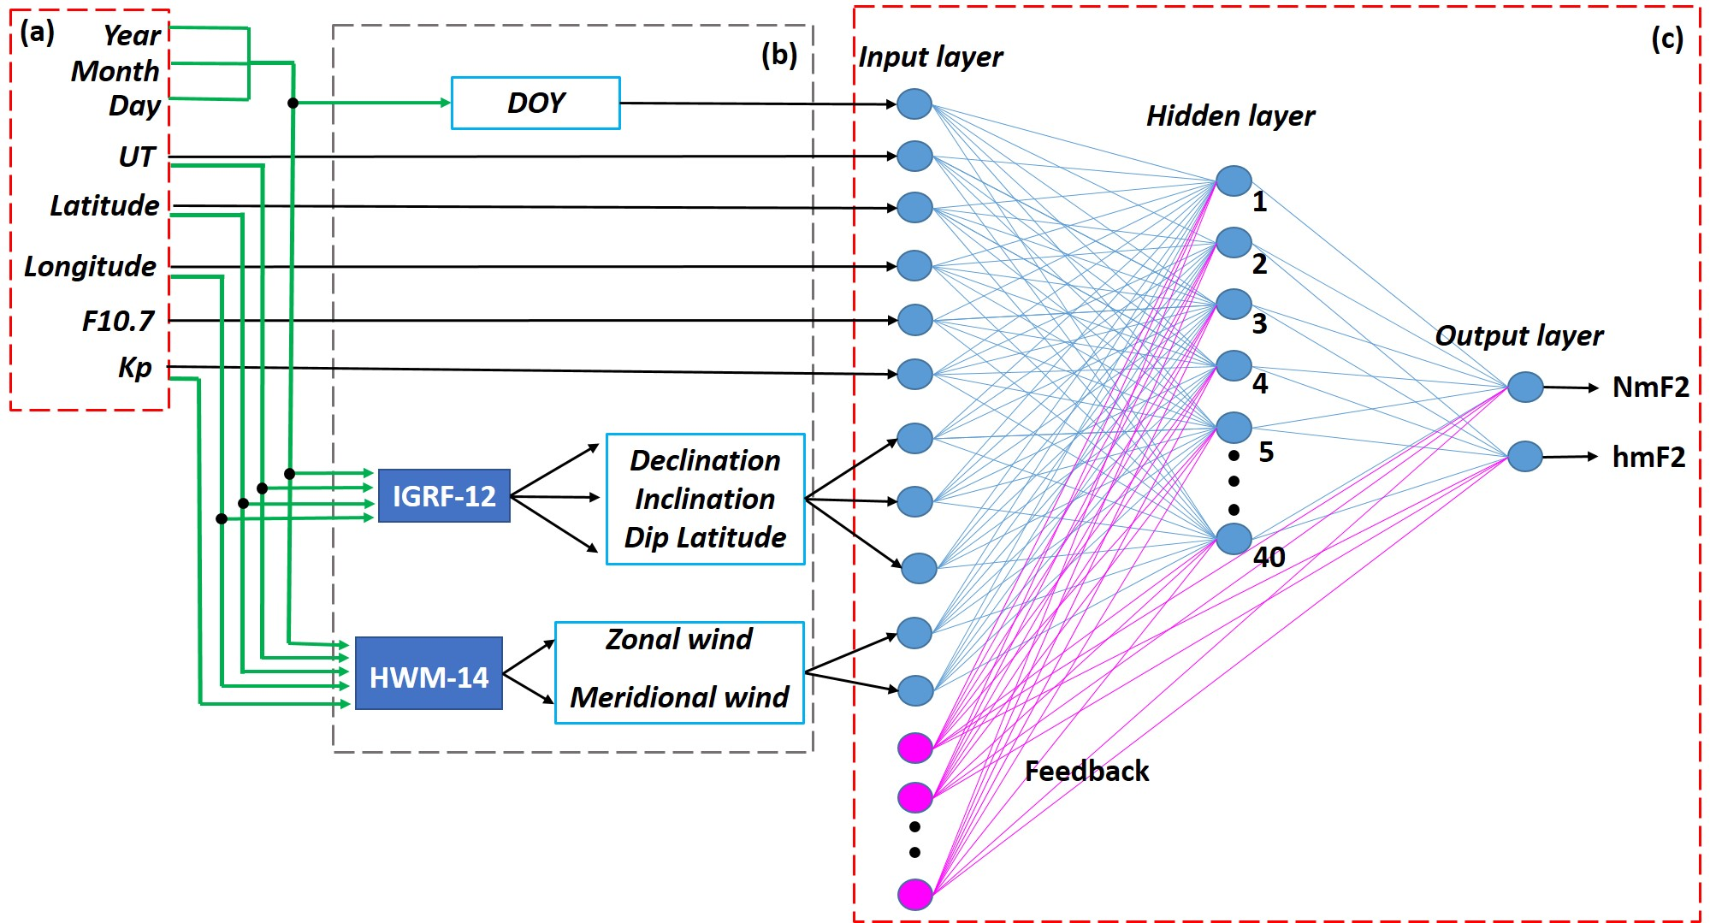
ANNIM-2D architecture:
Sai Gowtam and Tulasi Ram, 2017
Tulasi Ram et al., 2018
Primary inputs
Architecture of the neural network
Coupled with IGRF-12 and HWM-14
ML-HELIO 2022, 21-25 March, 2022, Boulder, CO.

Slide 7
ANN architecture
Inputs
DOY
UT
Altitude (h)
Latitude (ϕ)
Longitude (λ)
F10.7
Kp-index
Declination
Inclination
Dip latitude
Zonal wind
Meridional
wind
Database
Output
Nearly two decades of
Global Digisonde data
ANN
Topside sounders data
Hidden layer
with 40 neurons
GPS-RO data from
COSMIC, CHAMP, and GRACE
Electron Density
Profile
(70 – 1000 km)
IGRF-12
HWM-14
Gowtam et al., 2019
ML-HELIO 2022, 21-25 March, 2022, Boulder, CO.

Slide 8
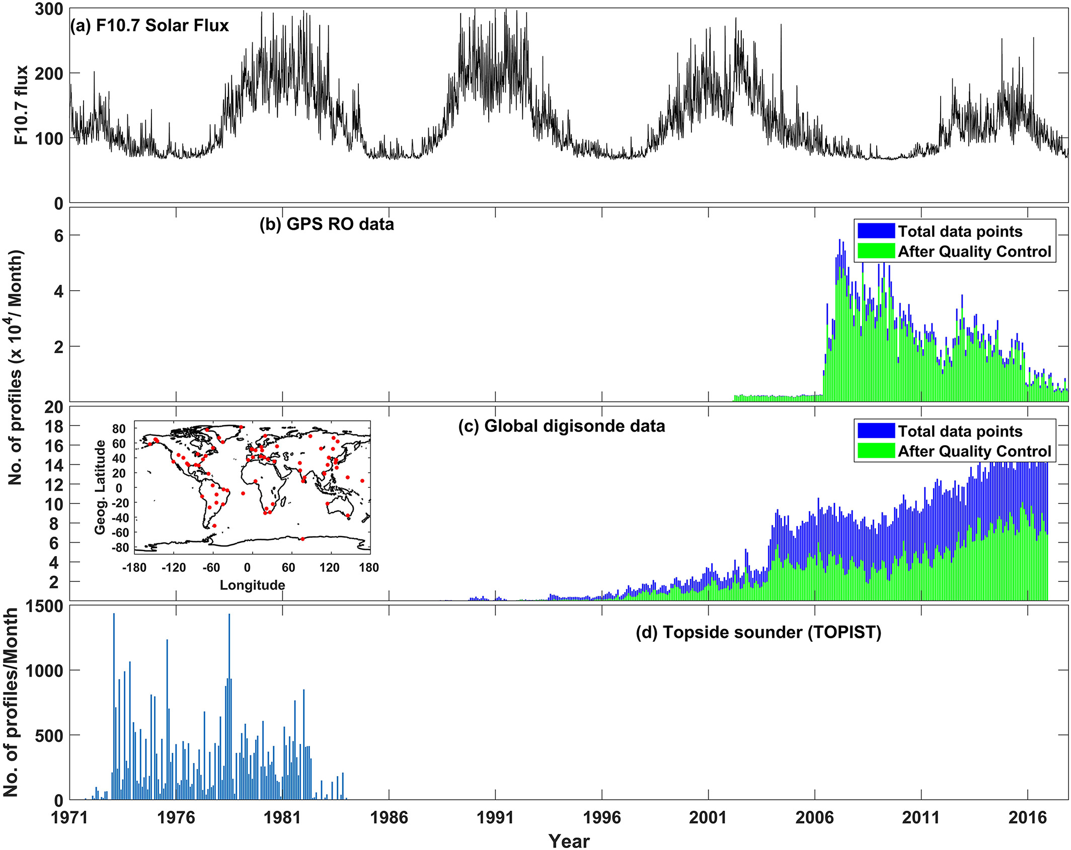
Data statistics:
~10 years of GPS-RO
~20 years of GIRO
ML-HELIO 2022, 21-25 March, 2022, Boulder, CO.

Slide 9
Model Workflow:
Preparing the data for training
Step 1
Global data set is divided into 15⁰x5⁰ spatial grids
Step 2
Training, Validation, and Testing
Step 3
Cluster of 840 neural networks
Matlab
ANNIM-3D
Step 4
ML-HELIO 2022, 21-25 March, 2022, Boulder, CO.

Slide 10
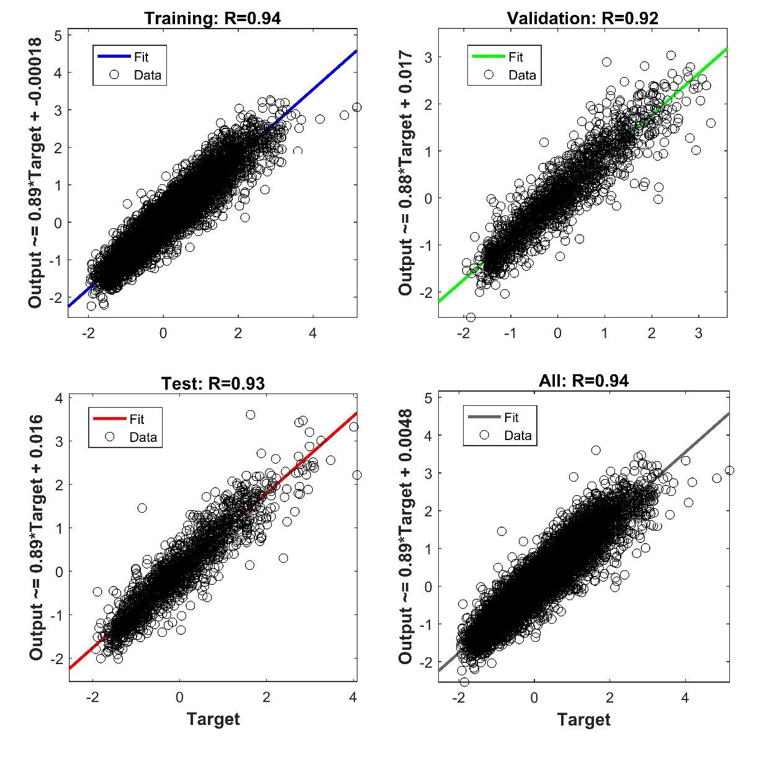
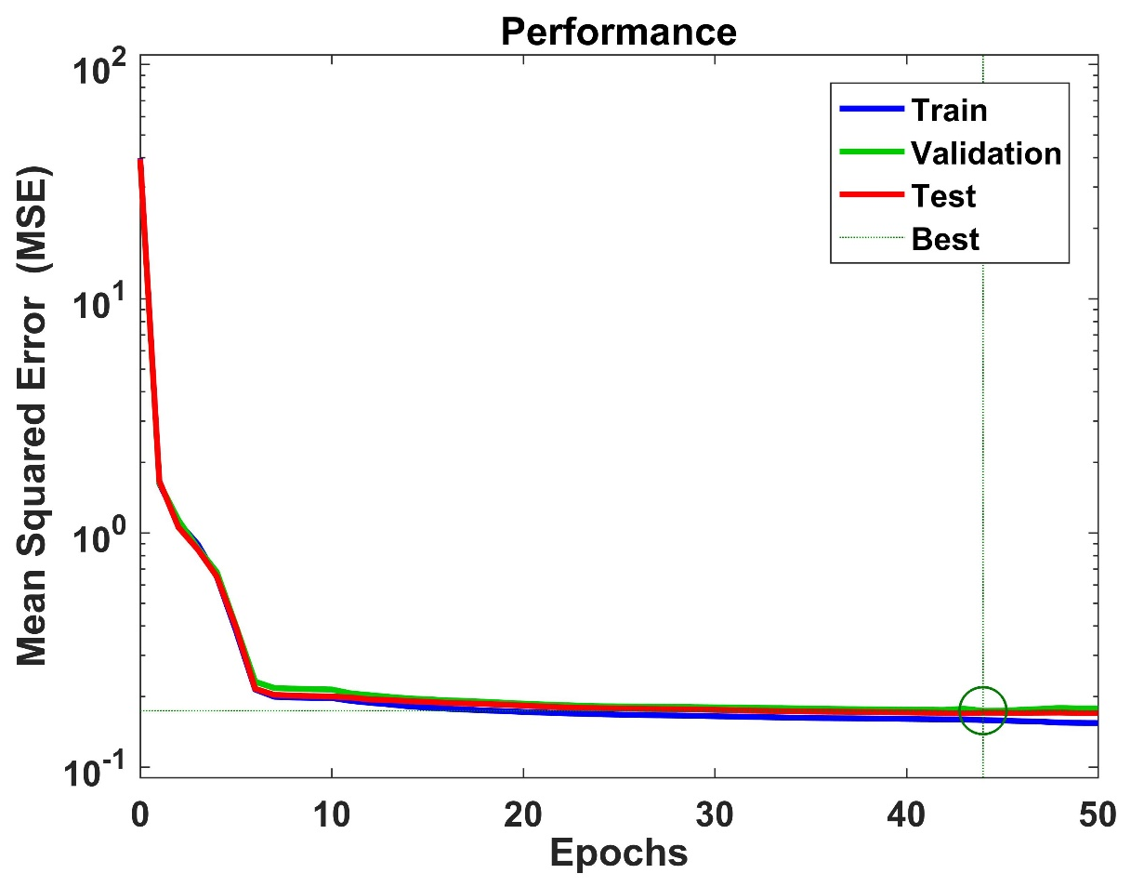
Training – 70%
Validation – 15%
Testing – 15%
The linear regression between normalized targets
And outputs during the training, validation and
testing
Performance of the network during learning process
ML-HELIO 2022, 21-25 March, 2022, Boulder, CO.

Slide 11
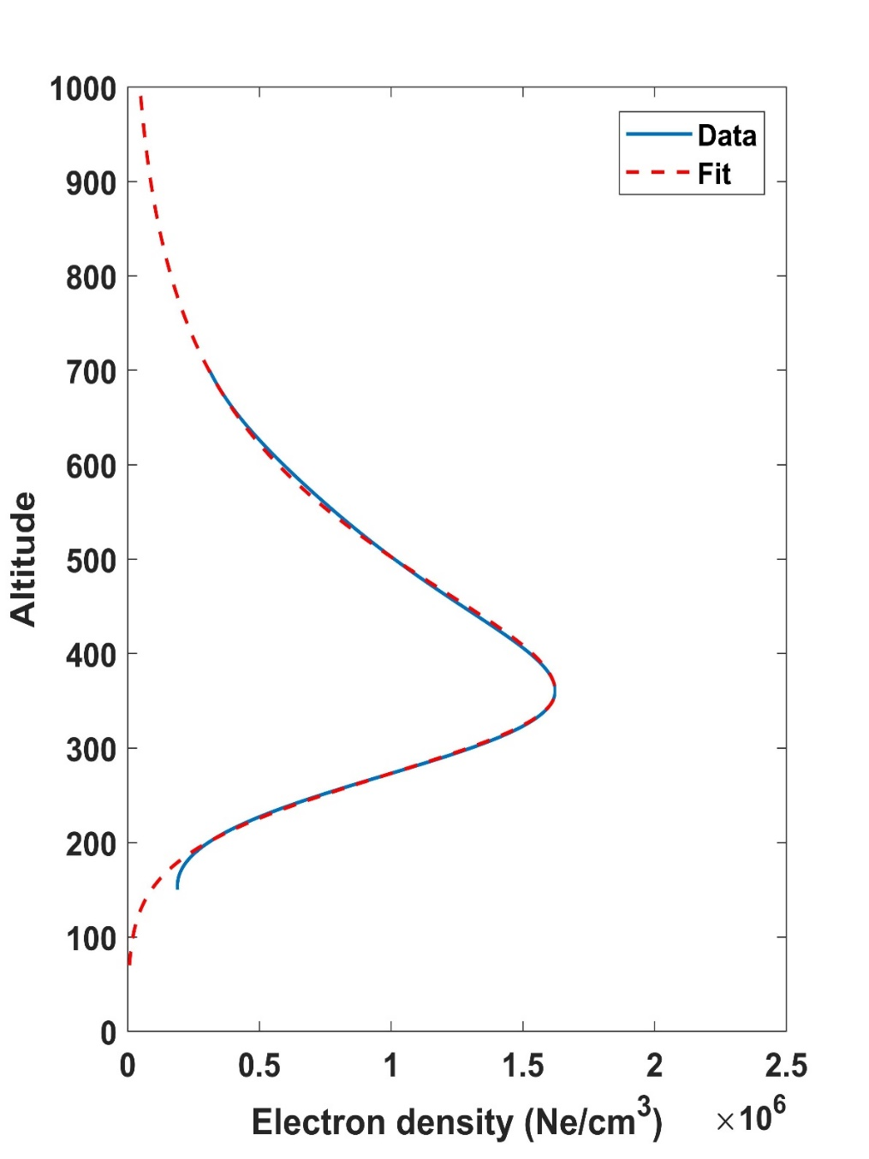
ANNIM – 3D
ANNIM
Fit ----
Topside scale height derived by fitting the α - Chapman equation
From hmF2 to hmF2 + 200km – to find unknown ‘H_{s}’
N(h) = N_{m}F₂. exp. [0.5(1 – z – e^{-z}])
Where z = (h-h_{m}F₂)/H_{s}
Topside
[Hargreaves, 1978;1992]
Regenerating profile from hmF2 to 1000 km
Bottomside electron density is derived by fitting IRI equation
IRI-equation:
N(h) = N_{m}F₂. exp. [(-X^{B1})/cosh(X)])
Where X = (h_{m}F₂-h)/B₀
[Bilitza et al., 2014]
Thickness parameter – B₀
Shape parameter – B₁
Bottomside
B₀ = hmf2 – h(NmF2*0.24) or (hmF2 – 150 km)
Regenerating profile from 70 km to hmF2
ANNIM – 3D outputs: Ne profile; NmF2; hmF2;
TEC; B0; B1; Hs
Electron density profile from 70 km to 1000 km
ML-HELIO 2022, 21-25 March, 2022, Boulder, CO.

Slide 12
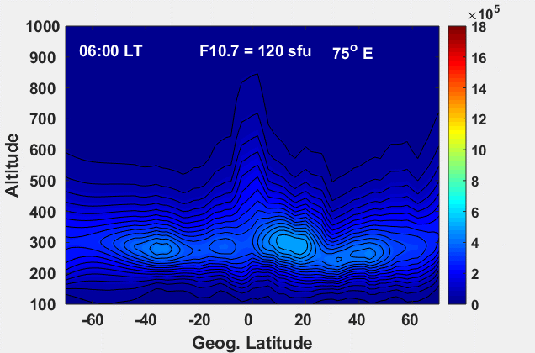
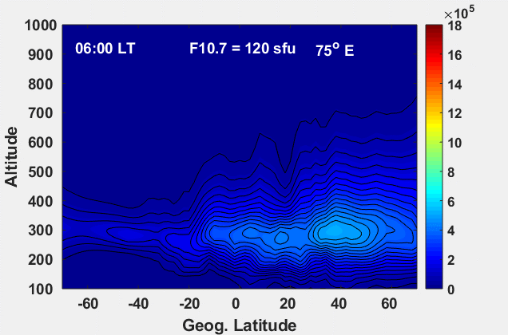
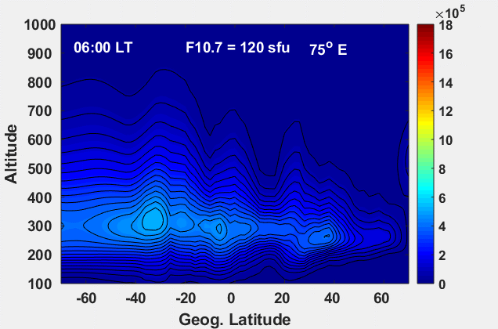
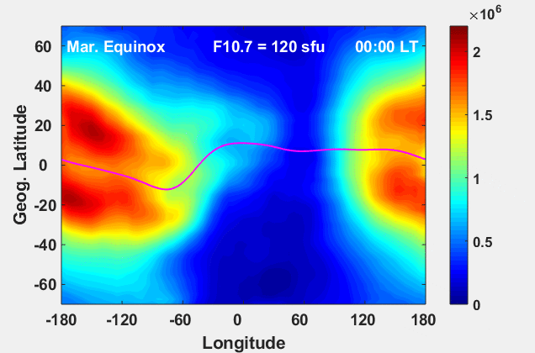
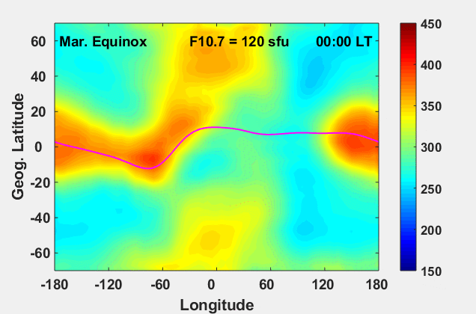
March Equinox
June Solstice
December Solstice
Temporal evolution of Equatorial Ionization Anomaly (EIA)
UT
ANNIM-3D
UT
Spatial variation of
NmF2 and hmF2
ML-HELIO 2022, 21-25 March, 2022, Boulder, CO.

Slide 13
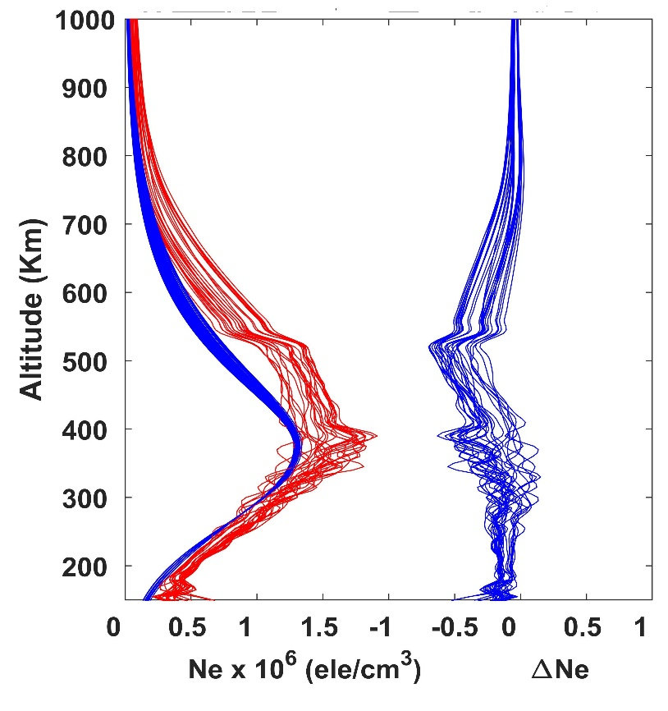
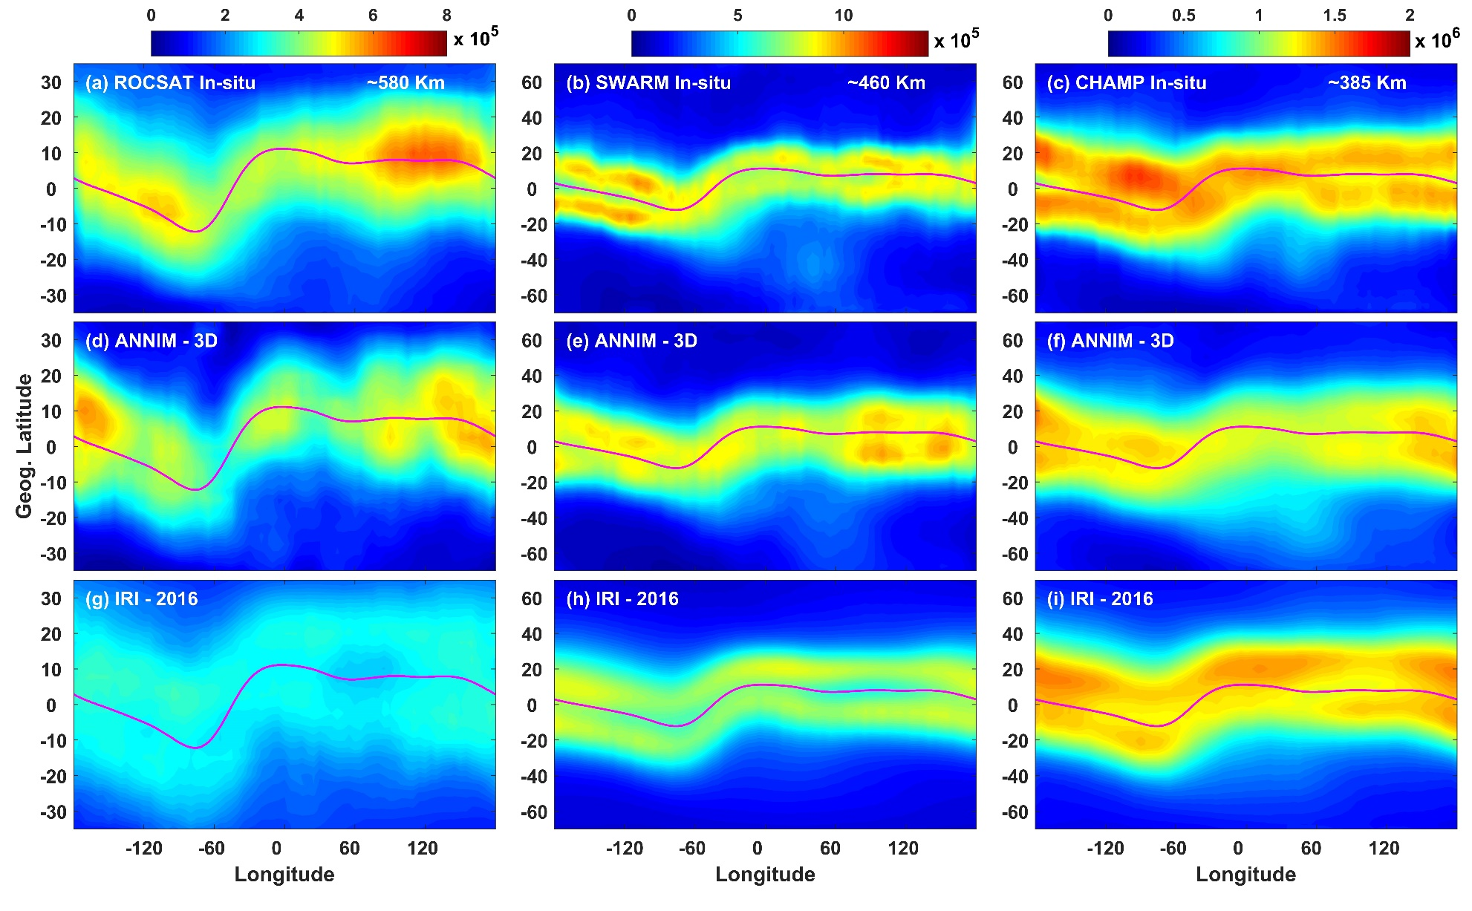
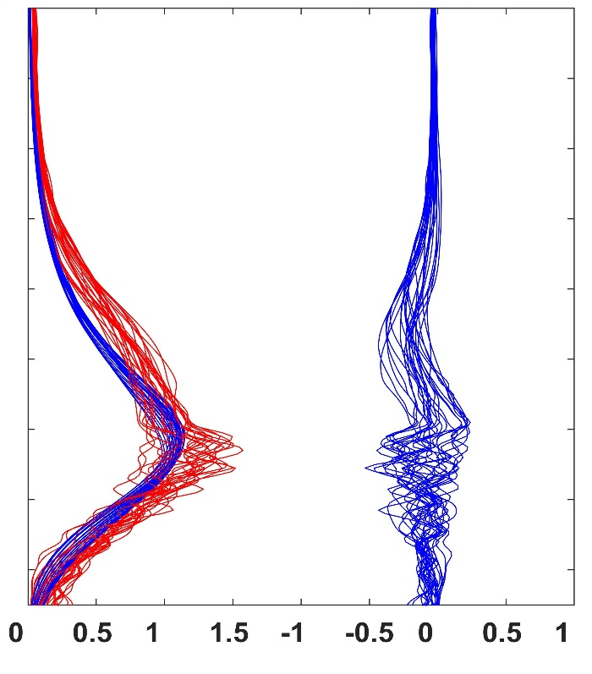
Comparison with Jicamarca ISR data (11.95ºS 76.87ºW) satellite in-situ measurements from ROCSAT, SWARM, and CHAMP
12 – 15 LT
ISR
ANNIM-3D
∆Ne
15 – 18 LT
12 ± 1 hour
ML-HELIO 2022, 21-25 March, 2022, Boulder, CO.

Slide 14
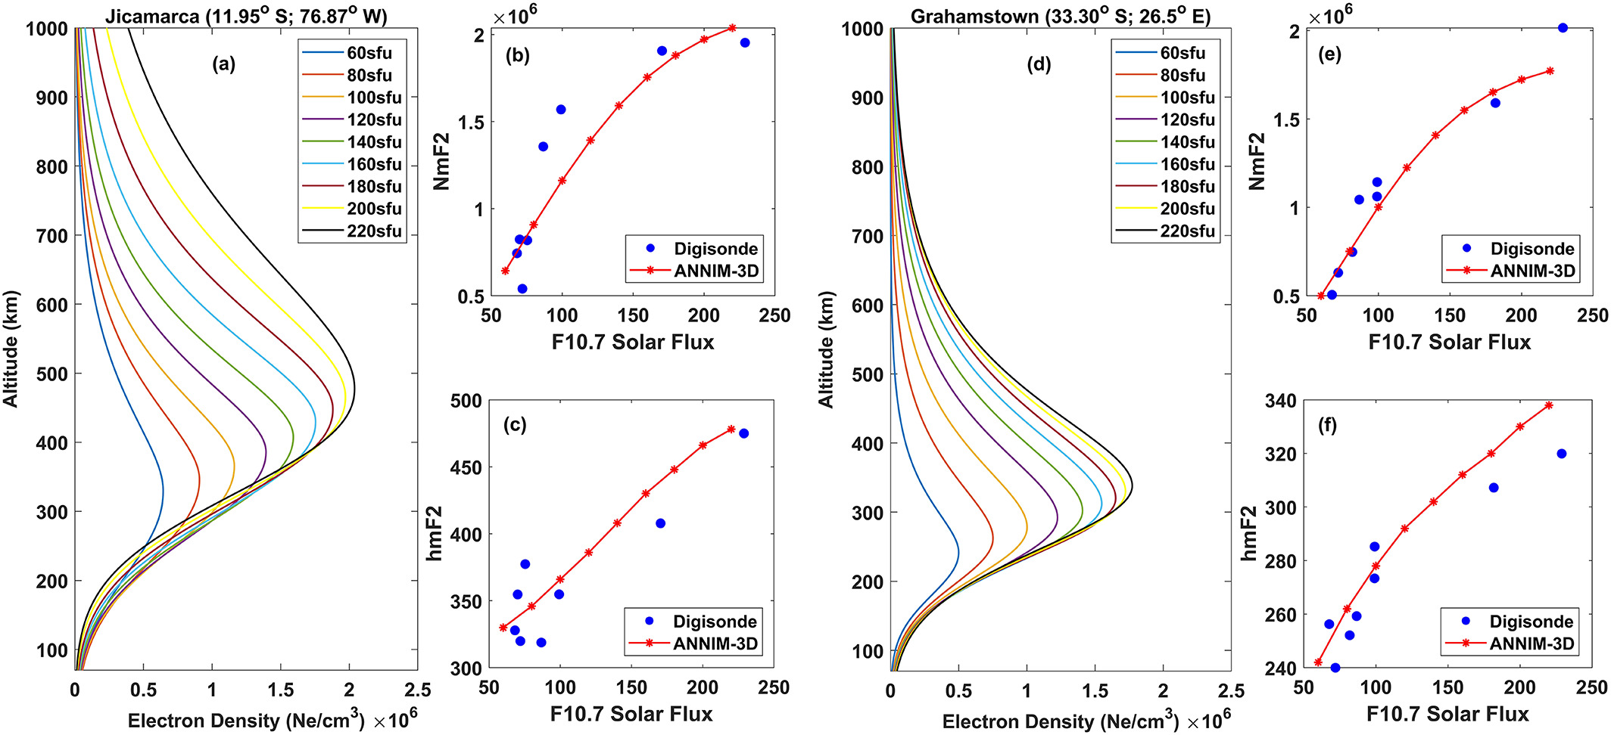
ANNIM-3D performance at different solar flux values:
ML-HELIO 2022, 21-25 March, 2022, Boulder, CO.

Slide 15
ANNIM-3D during disturbed space weather periods-F2 layer peak density:
ML-HELIO 2022, 21-25 March, 2022, Boulder, CO.

Slide 16
ANNIM-3D during disturbed space weather periods- Height of F2 layer peak density:
ML-HELIO 2022, 21-25 March, 2022, Boulder, CO.

Slide 17
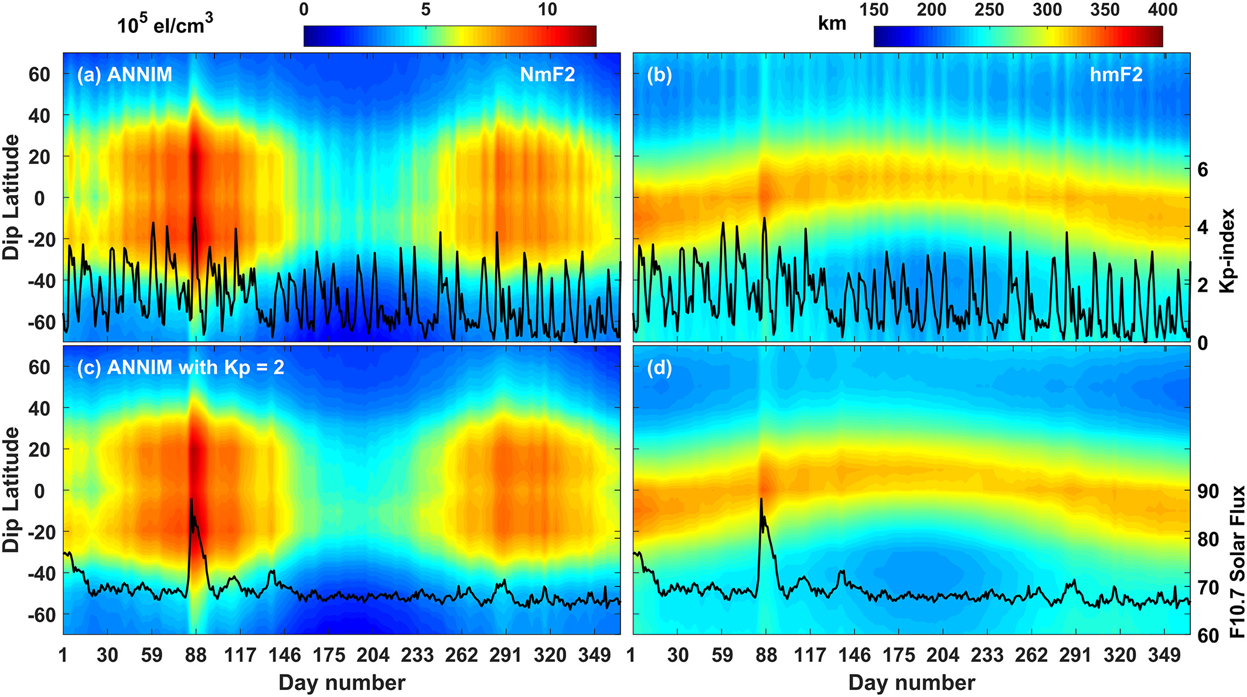
Controlled simulations with constant and varying Kp-index: CIR event 2009
Varying Kp-Index
Constant Kp-Index
ML-HELIO 2022, 21-25 March, 2022, Boulder, CO.

Slide 18
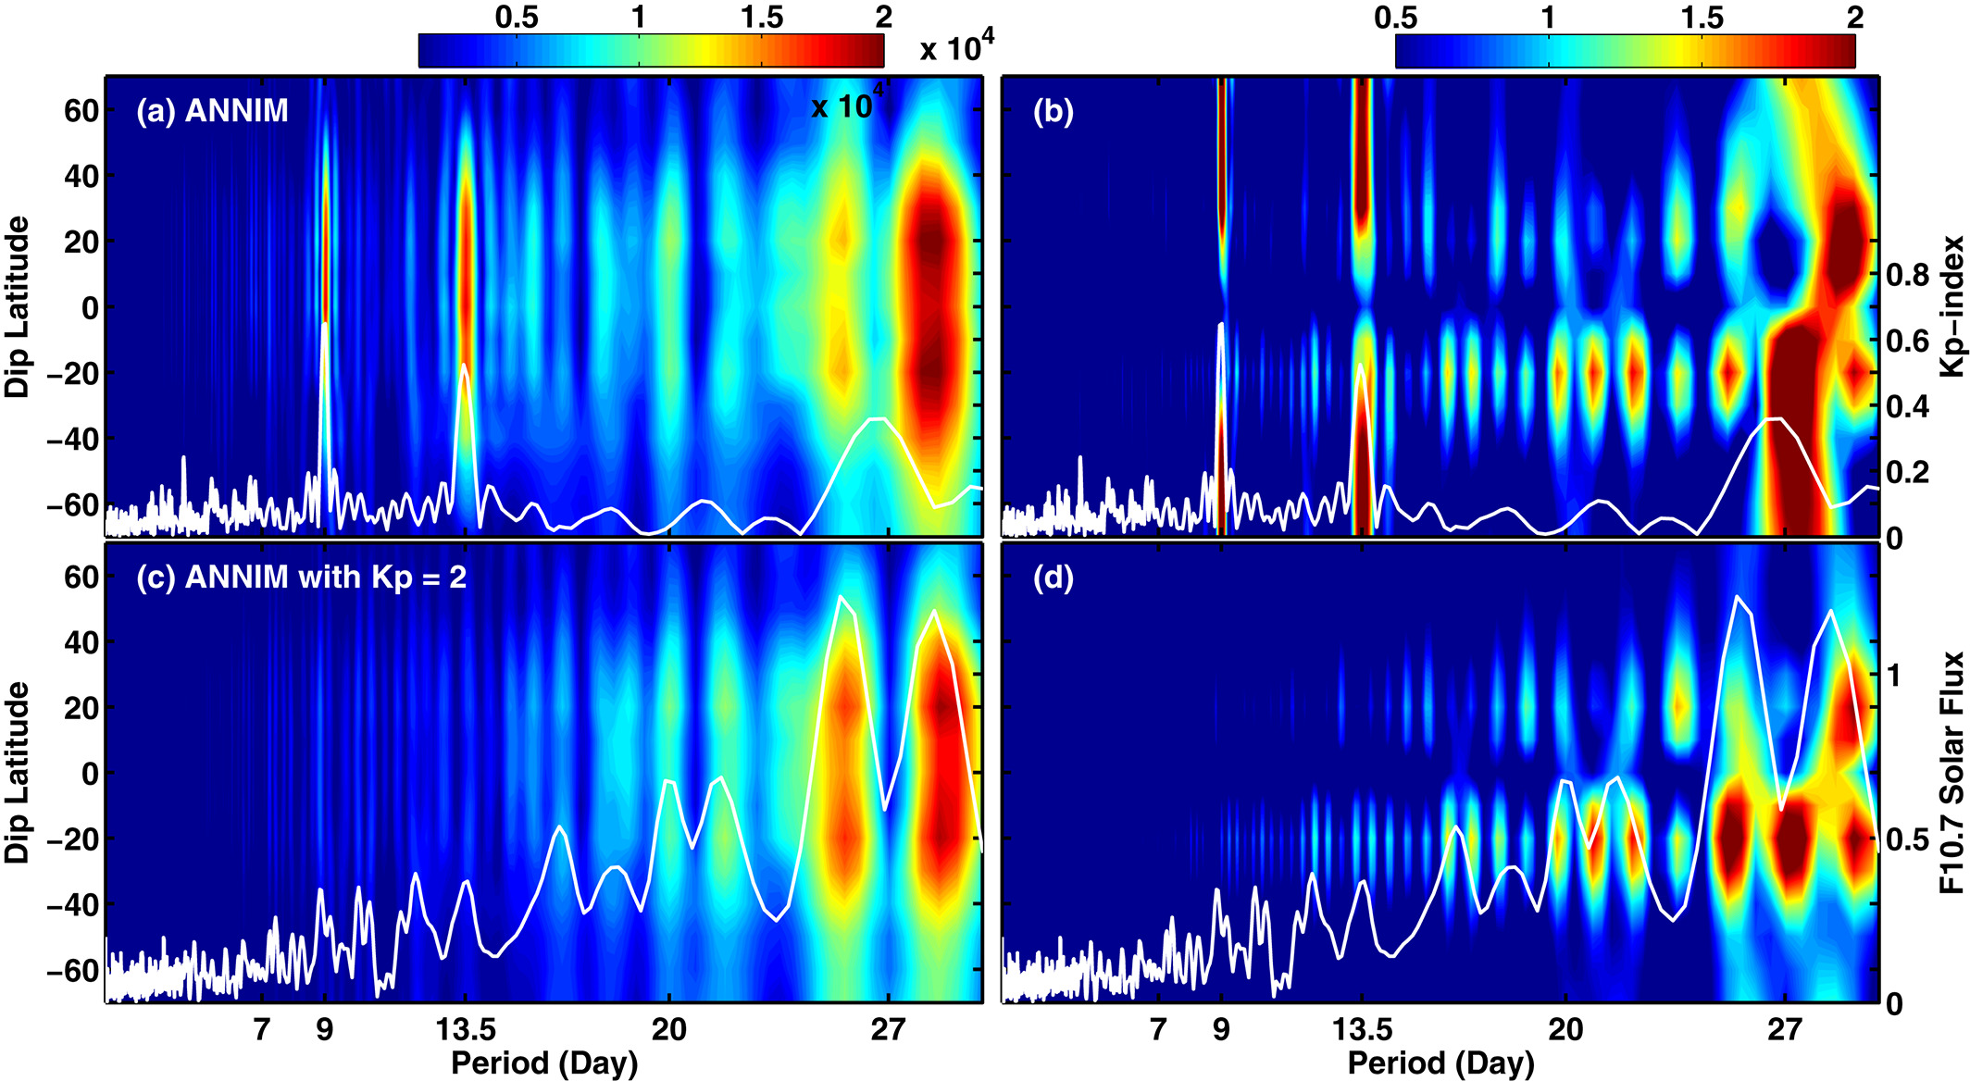
Controlled simulations with constant and varying Kp-index: CIR event 2009
Varying Kp-Index
Constant Kp-Index
ML-HELIO 2022, 21-25 March, 2022, Boulder, CO.

Slide 19
Major Challenges:
Different spatial and temporal resolutions between ground and space observation
Global vs regional training
More data or evenly distributed data…?
Inherent bias in the bottom side Ne profiles (below 200 km)
Predictions during severe space weather periods
ML-HELIO 2022, 21-25 March, 2022, Boulder, CO.

Slide 20
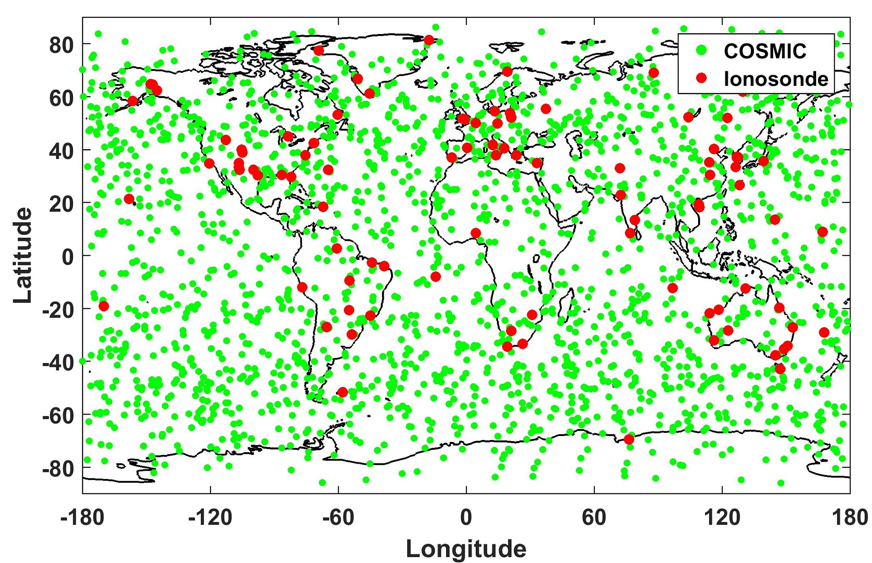
Major Challenges:
Different spatial and temporal resolutions between ground and space observation
Global vs regional training
More data or evenly distributed data…?
Inherent bias in the bottom side Ne profiles (below 200 km)
Predictions during severe space weather periods
ML-HELIO 2022, 21-25 March, 2022, Boulder, CO.

Slide 21
Major Challenges:
Different spatial and temporal resolutions between ground and space observation
Global vs regional training
More data or evenly distributed data…?
Inherent bias in the bottom side Ne profiles (below 200 km)
Predictions during severe space weather periods
ML-HELIO 2022, 21-25 March, 2022, Boulder, CO.

Slide 22
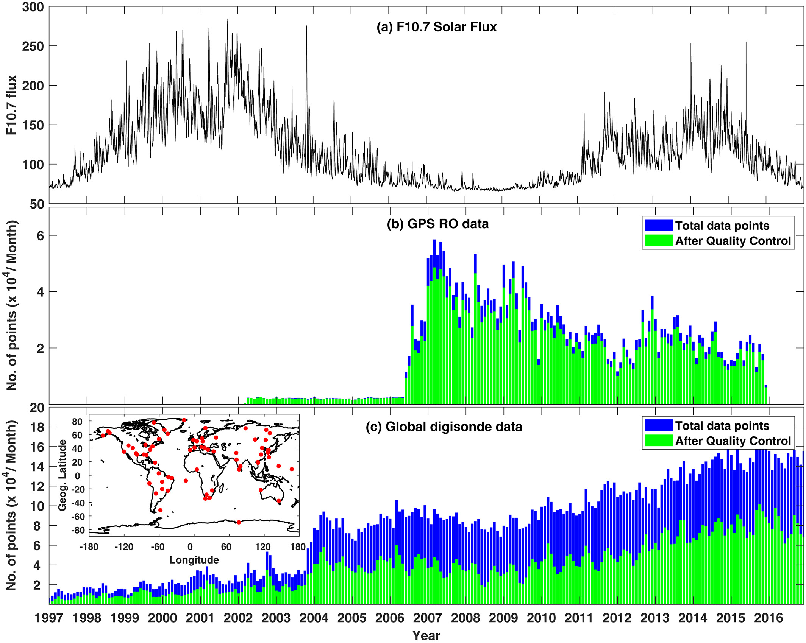
Major Challenges:
Different spatial and temporal resolutions between ground and space observation
Global vs regional training
More data or evenly distributed data…?
Inherent bias in the bottom side Ne profiles (below 200 km)
Predictions during severe space weather periods
ML-HELIO 2022, 21-25 March, 2022, Boulder, CO.

Slide 23
GPS RO Abel-inversion: LoS TEC into vertical Ne profiles
Major Challenges:
Different spatial and temporal resolutions between ground and space observation
Global vs regional training
More data or evenly distributed data…?
Inherent bias in the bottom side Ne profiles (below 200 km)
Predictions during severe space weather periods
r₀
(r₀)_{j}
(r₀)’_{j}
r_{j}
Concept of spherical symmetry
Spherical symmetry assumption in RO
Overestimated
Overestimated
-20⁰
0⁰
20⁰
Underestimated
Geom. Latitude
-- Tangent point/Occultation point
ML-HELIO 2022, 21-25 March, 2022, Boulder, CO.

Slide 24
Major Challenges:
Different spatial and temporal resolutions between ground and space observation
Global vs regional training
More data or evenly distributed data…?
Inherent bias in the bottom side Ne profiles (below 200 km)
Predictions during severe space weather periods
ML-HELIO 2022, 21-25 March, 2022, Boulder, CO.

Slide 25
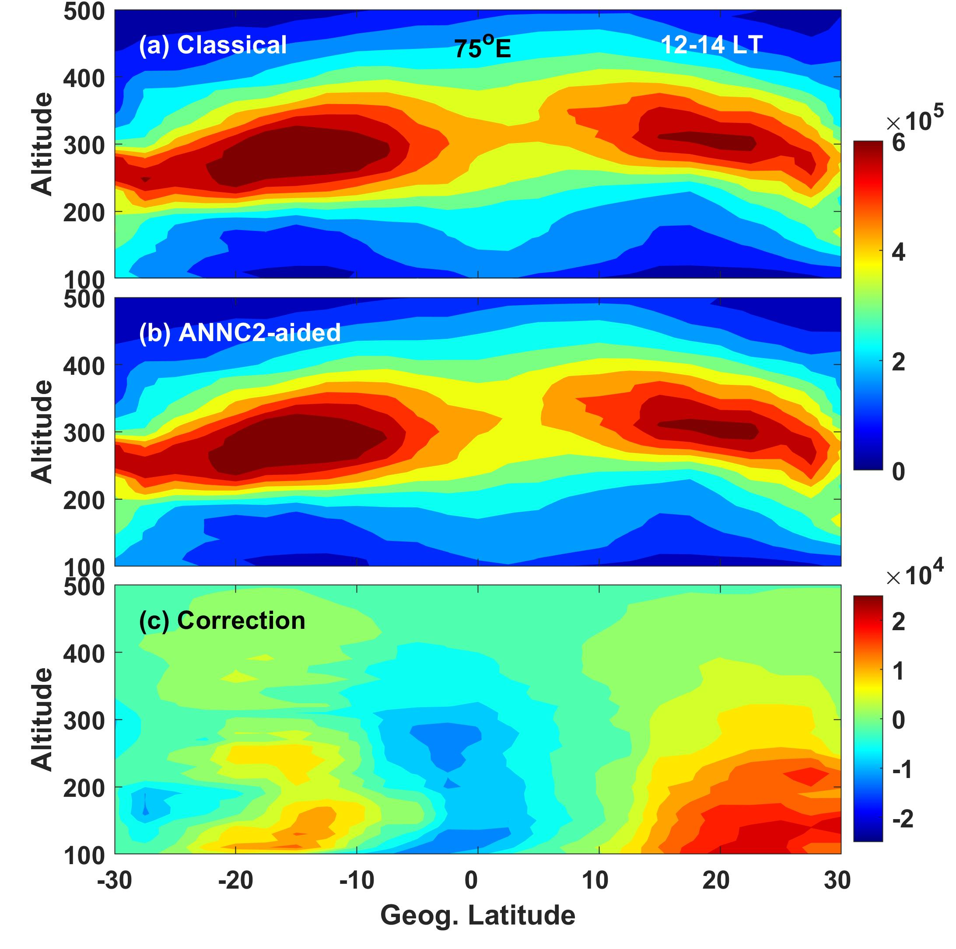
Major Challenges:
Different spatial and temporal resolutions between ground and space observation
Global vs regional training
More data or evenly distributed data…?
Inherent bias in the bottom side Ne profiles (below 200 km)
Predictions during severe space weather periods
Gowtam et al., 2021
ML-HELIO 2022, 21-25 March, 2022, Boulder, CO.

Slide 26
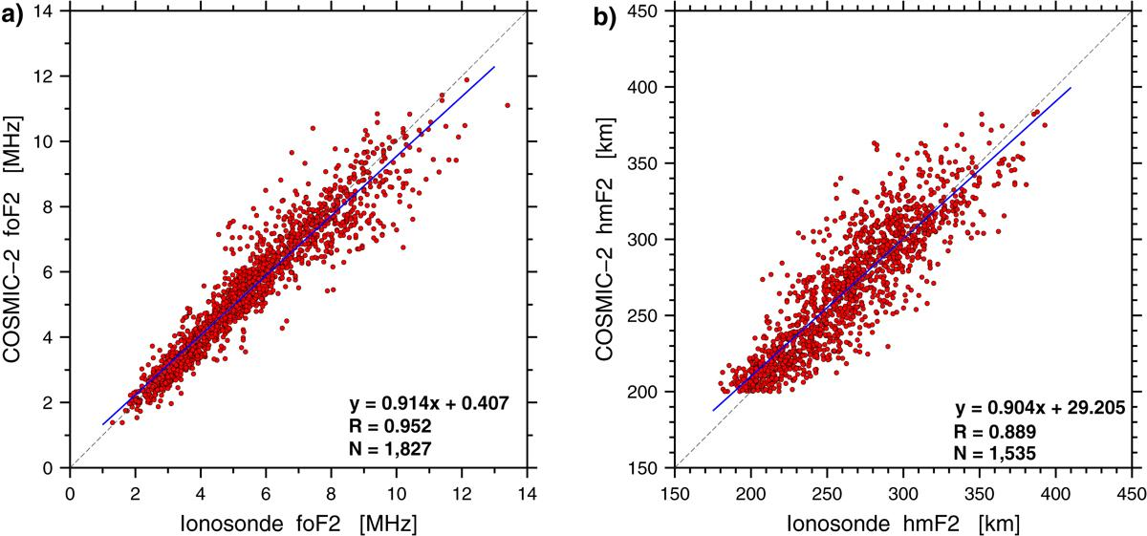
Major Challenges:
Different spatial and temporal resolutions between ground and space observation
Global vs regional training
More data or evenly distributed data…?
Inherent bias in the bottom side Ne profiles (below 200 km)
Predictions during severe space weather periods
Cherniak et al. 2021
ML-HELIO 2022, 21-25 March, 2022, Boulder, CO.

Slide 27
Major Challenges:
Different spatial and temporal resolutions between ground and space observation
Global vs regional training
More data or evenly distributed data…?
Inherent bias in the bottom side Ne profiles (below 200km)
Predictions during severe space weather periods
Data during such events is less than 10% of the total dataset
ML-HELIO 2022, 21-25 March, 2022, Boulder, CO.

Slide 28
Future directions
Evaluating the model performance during severe space weather periods
More data from COSMIC-2 mission
Development and testing with GP and other deep learning algorithms
ANNs + Kalman Filter
ML-HELIO 2022, 21-25 March, 2022, Boulder, CO.

Slide 29
Thank you…!
Email: svalluri@alaska.edu
Questions…?
ML-HELIO 2022, 21-25 March, 2022, Boulder, CO.

