Slide 1
Probing the solar coronal magnetic field with physics-informed neural networks
R. Jarolim¹, J. Thalmann¹, A. Veronig^{1,2}, T. Podladchikova³
¹University of Graz, Institute of Physics, Universitätsplatz 5, 8010 Graz, Austria
²University of Graz, Kanzelhöhe Observatory for Solar and Environmental Research, Kanzelhöhe 19, 9521 Treffen am Ossiacher See, Austria
³Skolkovo Institute of Science and Technology, Bolshoy Boulevard 30, bld. 1, Moscow 121205, Russia
ML Helio Conference
2022-03-21
This research has received financial support from the European Union’s Horizon 2020 research and innovation program under grant agreement No. 824135 (SOLARNET).

Slide 2
Introduction
X1.5 flare - 2011-03-09 23:23:00
Understand the build-up and initiation of solar eruptions requires estimation of the 3D coronal magnetic field
Nonlinear force-free (NLFF) modeling is applied to extrapolate photospheric vector magnetograms (Wiegelmann et al. 2017)
$∇∙B=0$ (divergence-free)
$\left|J×B\right|=0$ (force-free)
Extrapolation of a single layer
Force-free assumption not valid for photospheric heights (not perfectly posed problem)
SDO (AIA 131 Å, HMI LOS magnetogram) – 12h @12 min cadence

Slide 3
Method
Solve boundary-value problem determined by PDEs
Integrate observational data and physical NLFF model (Raissi et al. 2019)

Slide 4
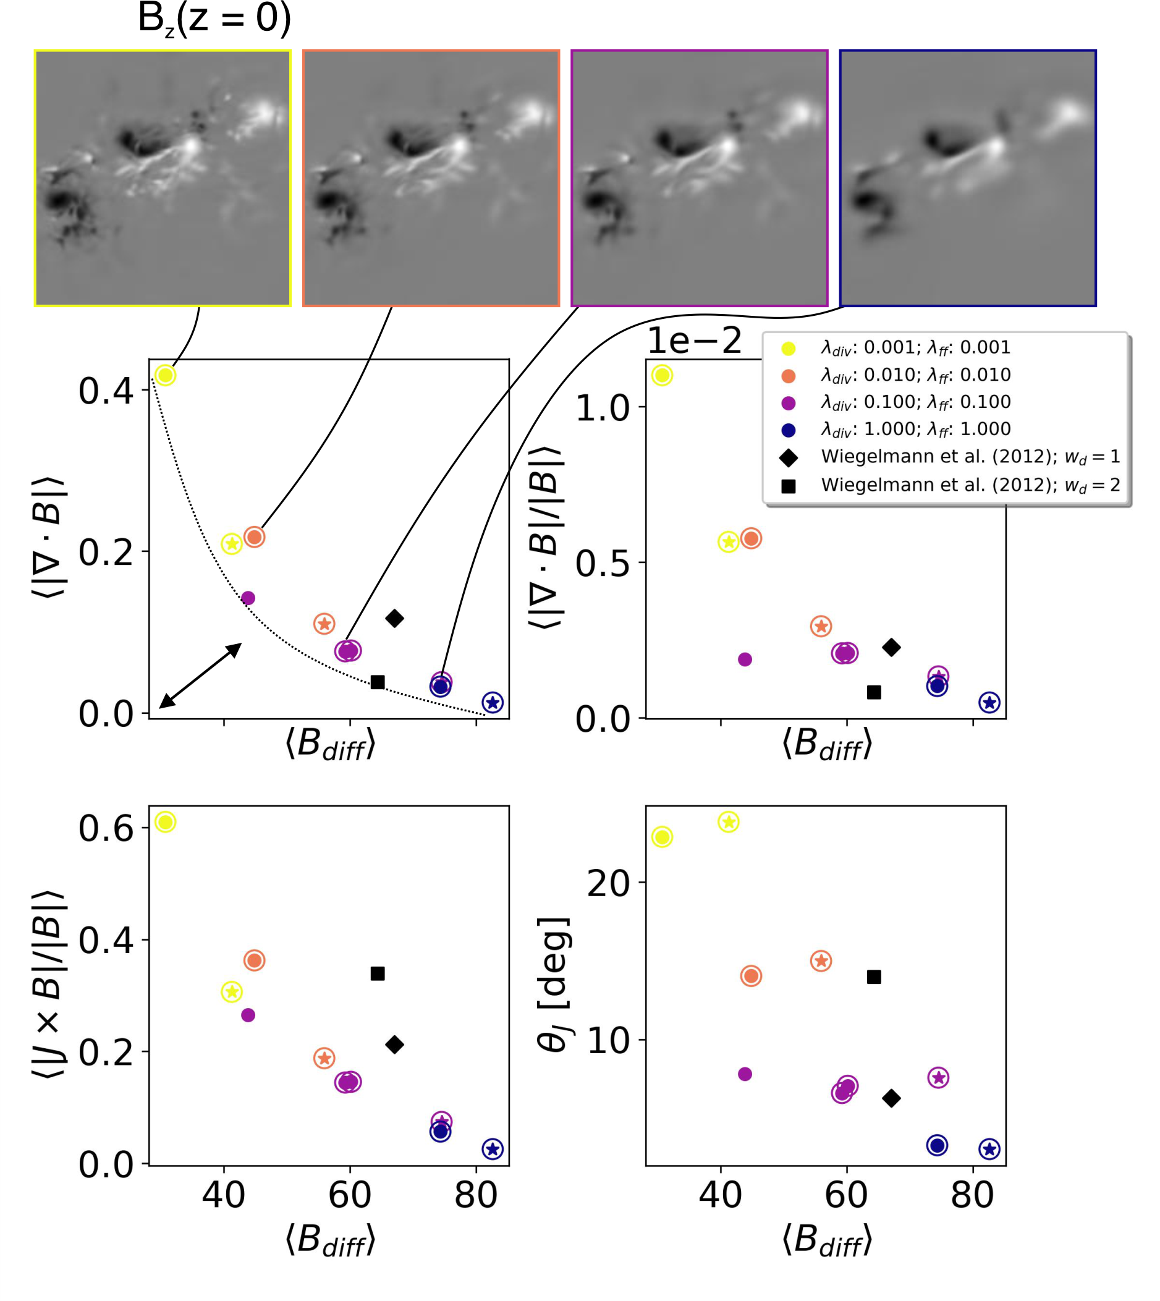
Trade-off between observation and physical model
Understand the relation between the data and the underlying physics
Parameters weighting defines flexible solution $λ_{div/ff}=0.001−1.0$
Metrics estimate deviation from
Physical model (y-axis)
Observed magnetic field at $z=0$ (x-axis)
Trade-off line defines attainable solutions

Slide 5
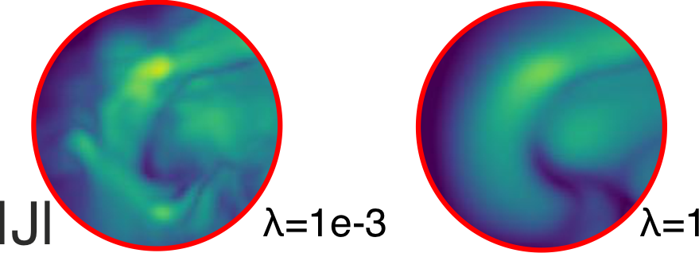
Trade-off between observation and physical model
0.001
1
Simulations show a similar magnetic topology (integrated current density)
At small scales more structured when physical constrains are loosened

Slide 6
Simulation of time series
Temporal evolution prior to eruptive events
Assuming temporally adjacent solutions are similar
Simulation of NOAA 11158 at full cadence (5 days @ 12 minutes)
Total computation time <13 hours
(c.f., Sun et al. 2012)

Slide 7
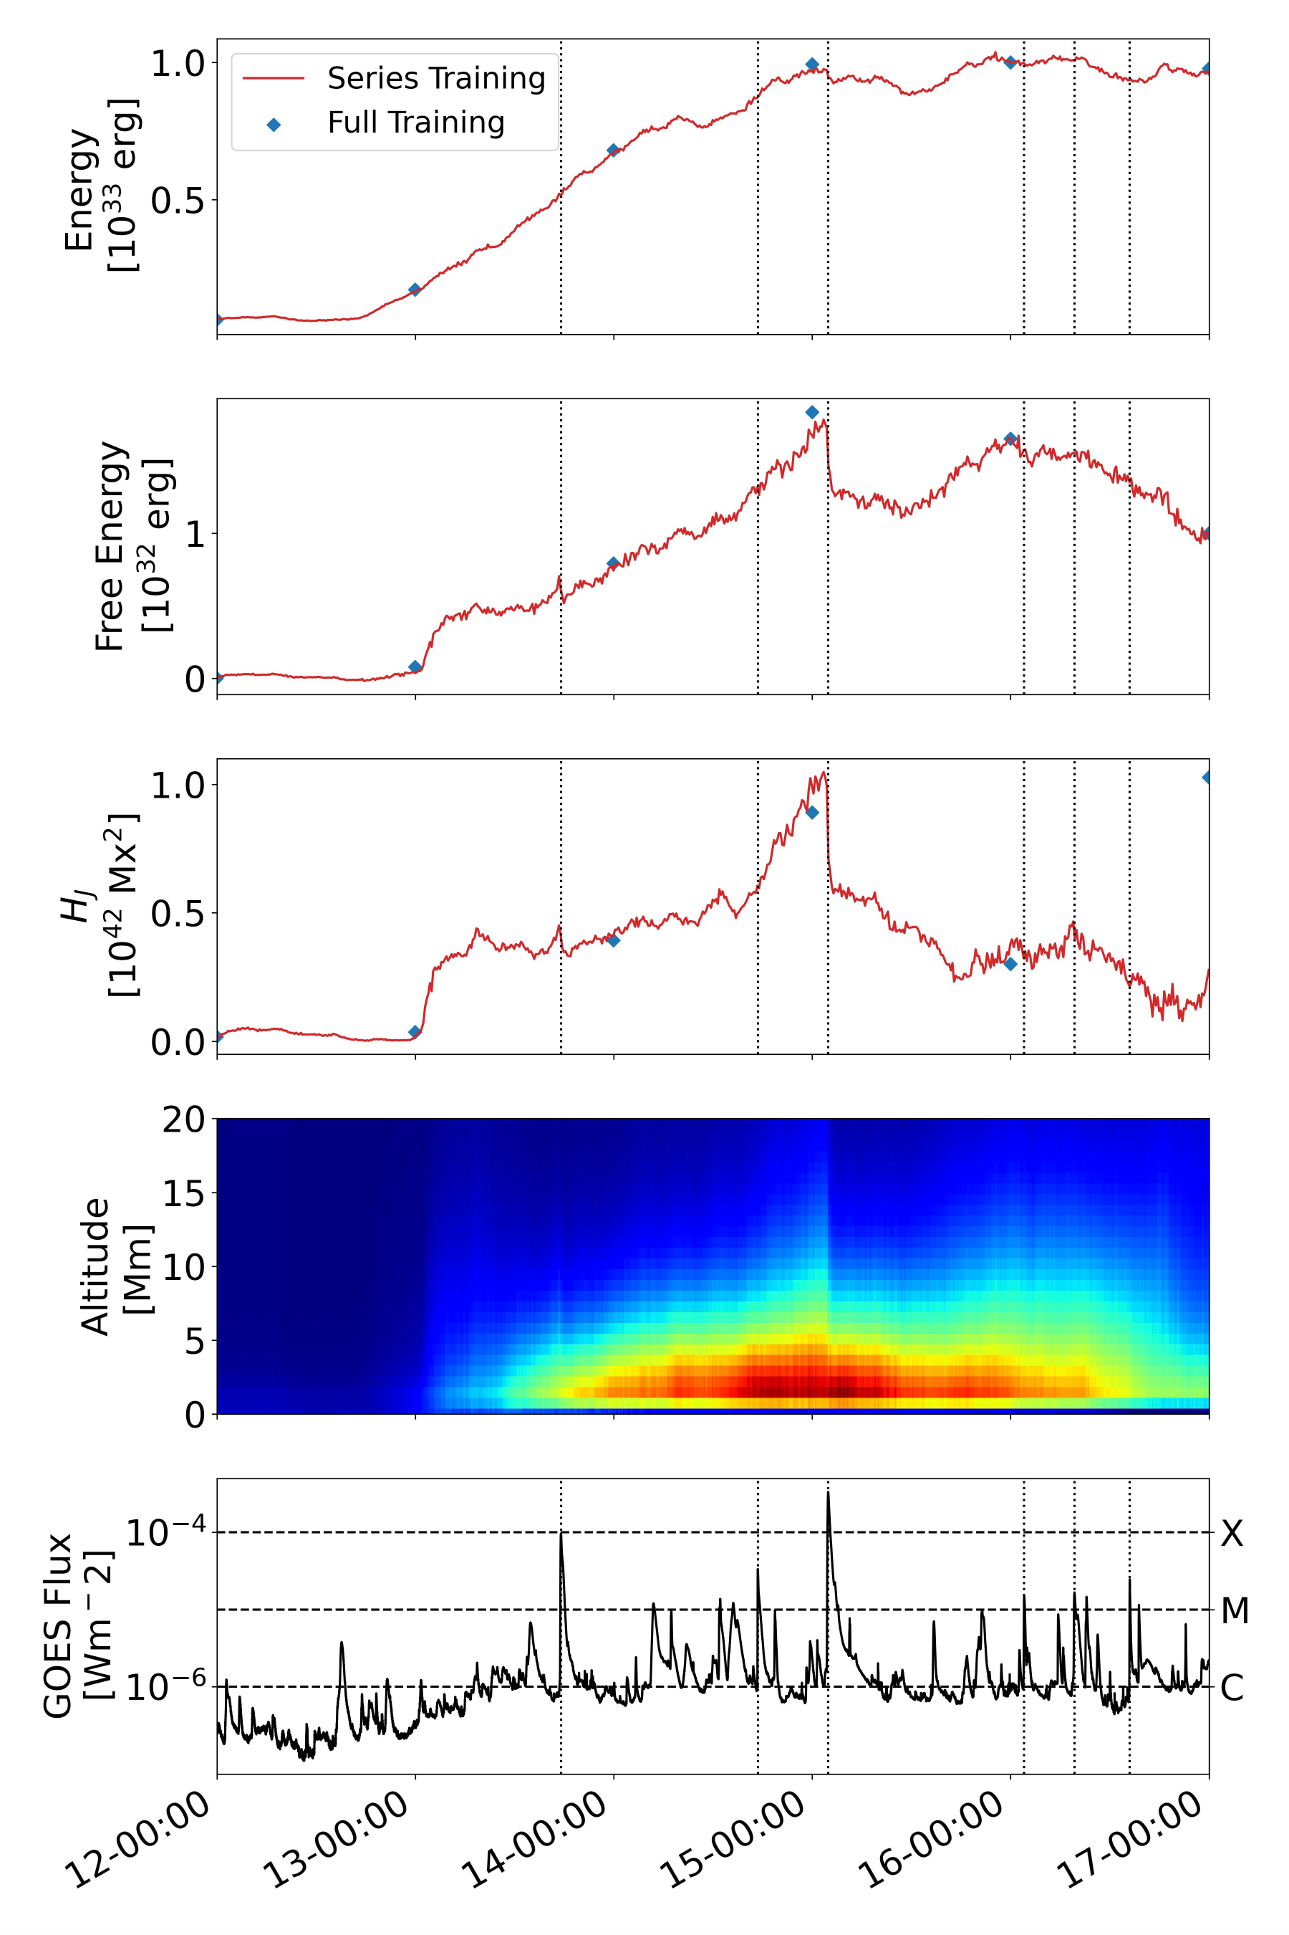
Simulation of time series
Iterative training (Series) gives similar results to training from scratch (Full)
Jumps in free magnetic energy and helicity relate to solar flares

Slide 8
Simulation of time series

Slide 9
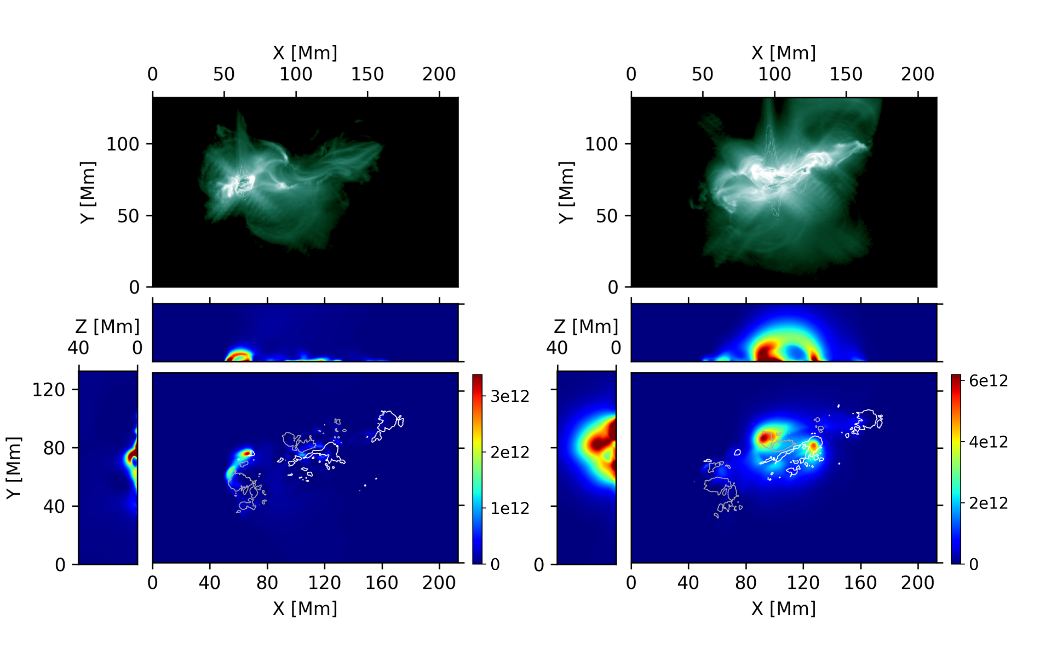
Simulation of time series
Depleted free magnetic energy during flare events aligns with integrated EUV emission
M-class flare (left)
Eastern polarity inversion line
Not visible in integrated free magnetic energy
X-class flare (right)
Central polarity inversion line
Characteristic energy release along the flux-rope

Slide 10
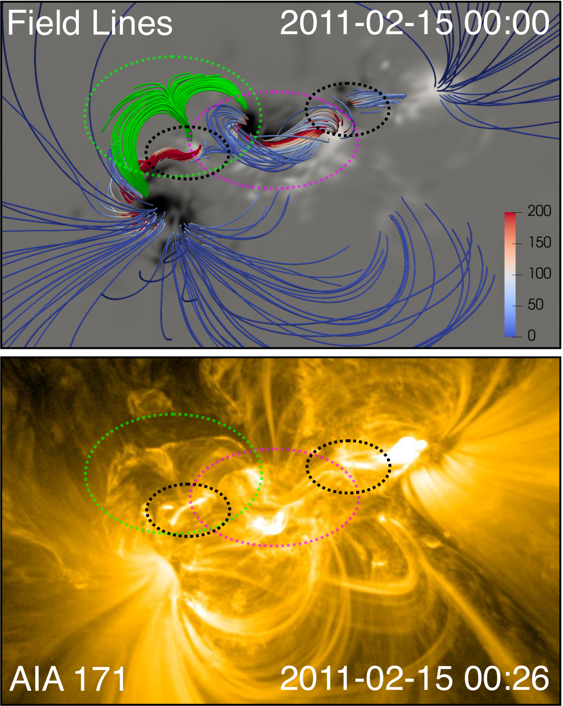
Simulation of time series
Magnetic field line traces of the central components of the active region
Central flux rope (pink)
Secondary flux ropes (black)
Eruptive structure (green)

Slide 11
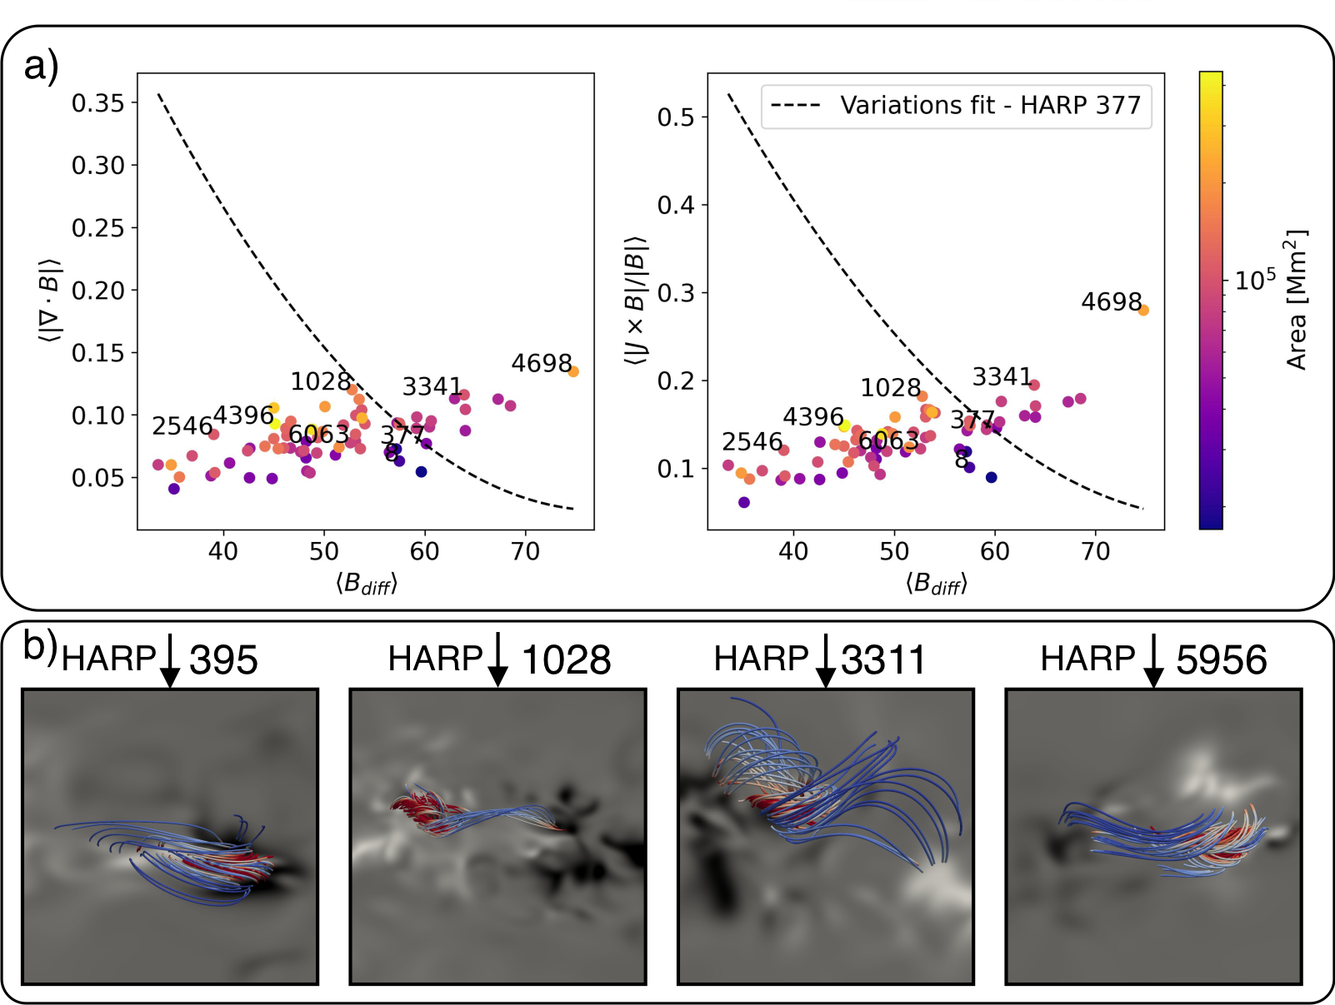
Application to different active regions
Application to 66 individual solar active regions (close to M- or X-class flare)
High-quality solutions independent of magnetic configuration and area

Slide 12
Conclusion
State-of-the-art results in NLFF magnetic field modeling
First real-time magnetic field extrapolations
next generation of space-weather monitoring and flare predictions
Flexible solution without pre-processing
Possible extension to magnetohydrodynamics
Project Page: Neural Network Force-Free (NF2) modeling https://github.com/RobertJaro/NF2
Extrapolation of arbitrary ARs with online resources
Paper: submitted

Slide 13
References
Wiegelmann, T., Petrie, G. J. D. & Riley, P. Coronal Magnetic Field Models. 210, 249–274 (2017).
Raissi, M., Perdikaris, P. & Karniadakis, G. E. Physics-informed neural networks: A deep learning framework for solving forward and inverse problems involving nonlinear partial differential equations.Journal of Computational Physics 378, 686–707 (2019).
Wiegelmann, T. et al. How Should One Optimize Nonlinear Force-Free Coronal Magnetic Field Extrapolations from SDO/HMI Vector Magnetograms? 281, 37–51 (2012).
Sun, X. et al. Evolution of Magnetic Field and Energy in a Major Eruptive Active Region Based on SDO/HMI Observation. 748, 77 (2012).
Valori, G. et al. Magnetic Helicity Estimations in Models and Observations of the Solar Magnetic Field. Part I: Finite Volume Methods. 201, 147–200 (2016). 1610.02193.

Slide 14
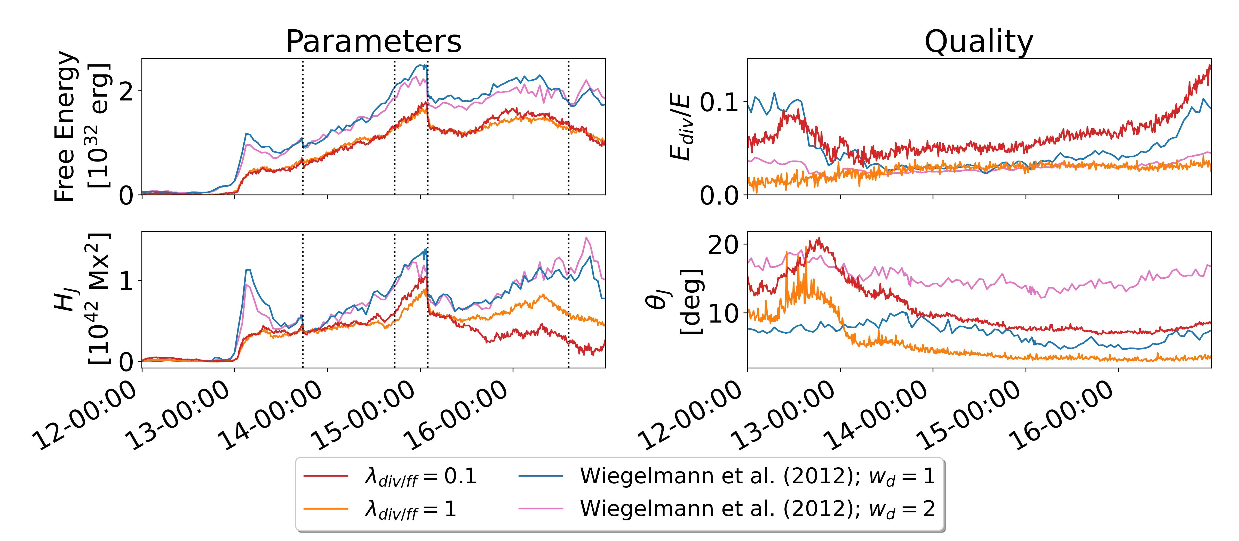
Comparison to a state-of-the-art NLFF method
Two configurations per method
Parameters (left)
Trends are similar
Largest difference at flux emergence and later evolution of helicity
Quality (right)
Qualities in same range
$E_{div}/E≲\text{0.1}$ satisfied (Valori et al. 2016)

